Slide 1
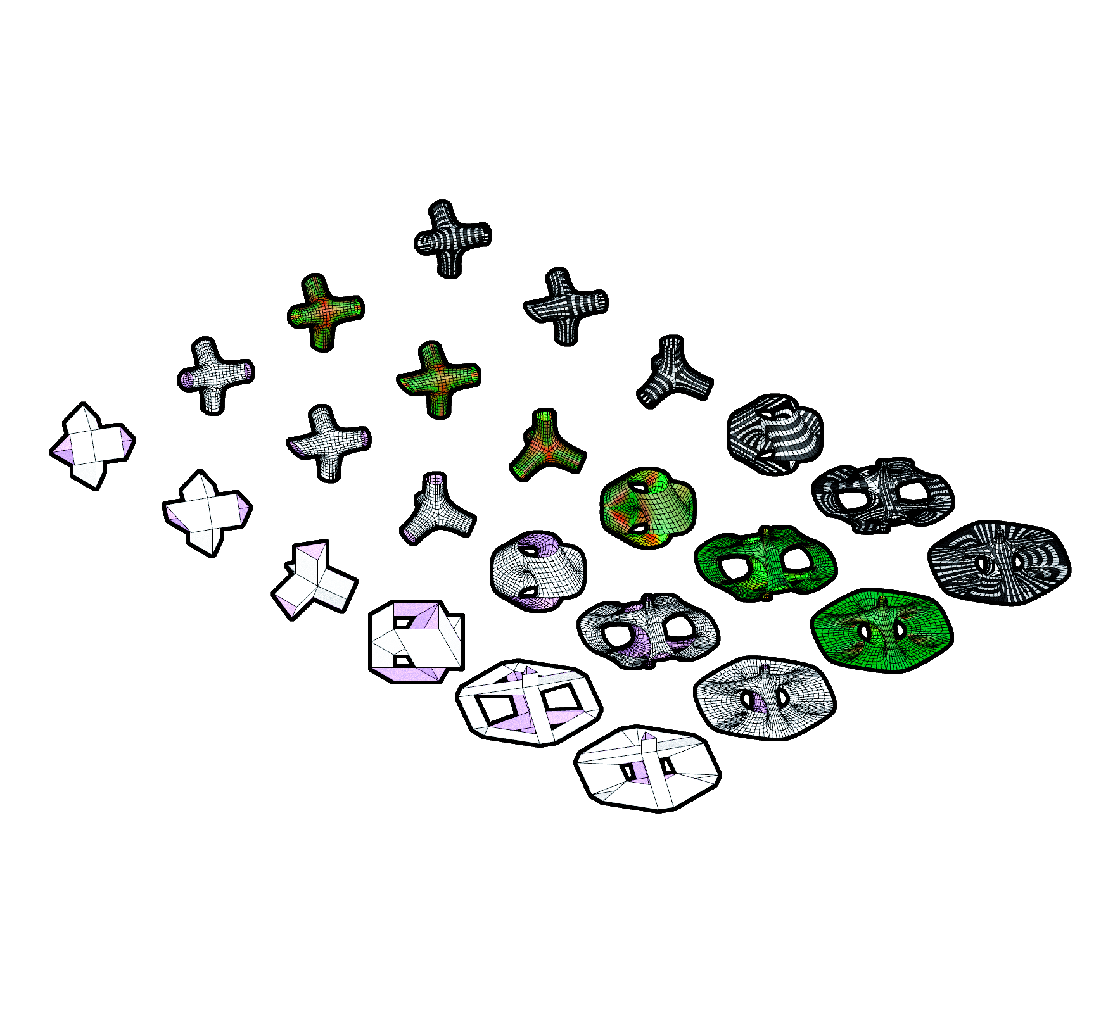

Software 1 - inFORMed geometries
IaaC / 18/11/2021
Faculty / Andrea Graziano
Assistant / Eugenio Bettucchi
MRAC
MeX_PRIMER
Alfred Cecil Bowles
Master in Robotics and Advanced Construction
Mit Vasant Patel
Huanyu Li
Notes:
This is the cover template
You might change just the title and the team members names (do not change fonts or colors here)
In case you collect some videos together in a longer one, use this as introductory image (5 seconds)

Slide 2
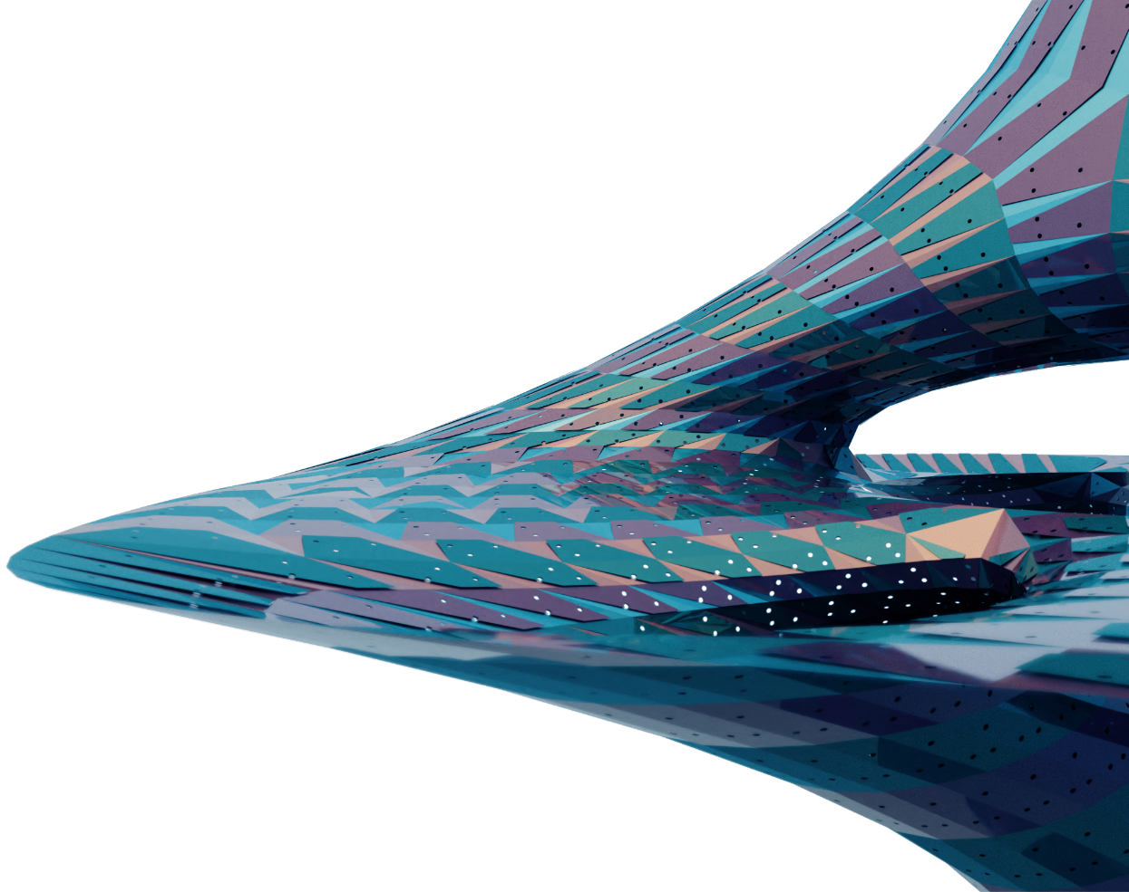

MeX_PRIMER
AN EXPLORATION IN MESHING USING SUBDIVISION AS A PRIMER FOR THE GENOME DICTATING THE GEOMETRIES.
IT SETS A SCRIPTED ENVIRONMENT WITH THE PRIMER AT ITS VERY CORE CHANGING AND CREATING GEOMETRIC PATTERNS.

Slide 3
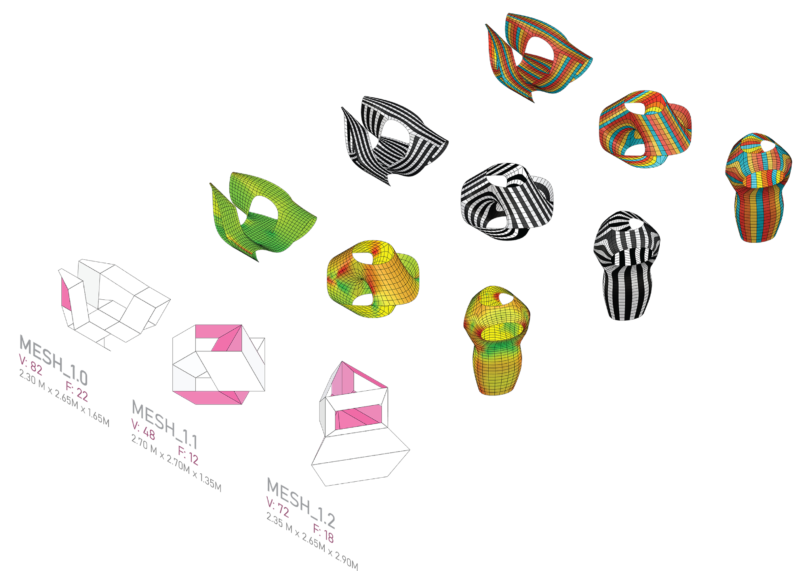
MESH GEOMETRIES
CATMULL-CLARK SUBDIVISION CONFIGURATION:
LEVEL : 2
SMOOTH NAKED EDGES : CORNER FIXED
ANCHOR POINTS: : NAKED EDGES
Notes:
Empty white slide template
Fill in your project title and the team members names

Slide 4
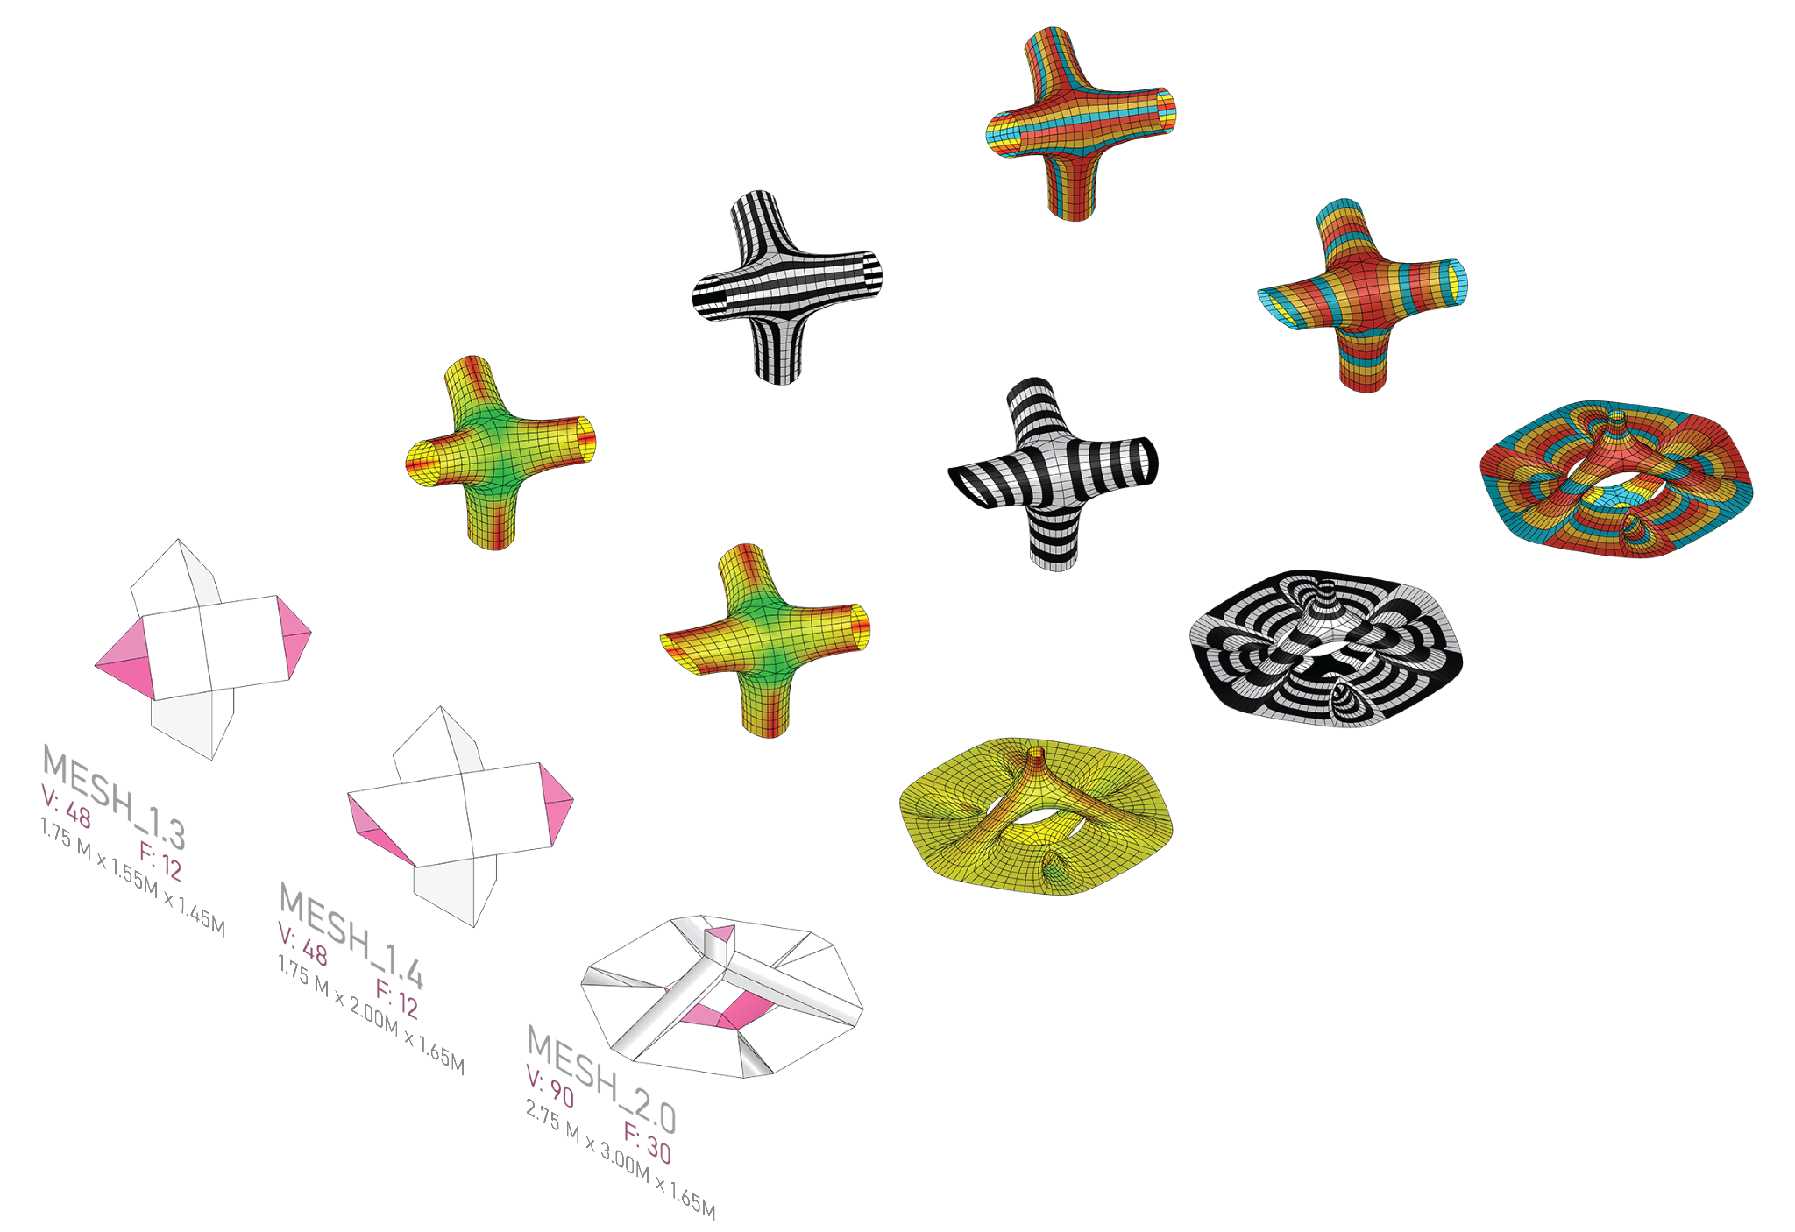
MESH GEOMETRIES
CATMULL-CLARK SUBDIVISION CONFIGURATION:
LEVEL : 2
SMOOTH NAKED EDGES : CORNER FIXED
ANCHOR POINTS: : NAKED EDGES

Slide 5
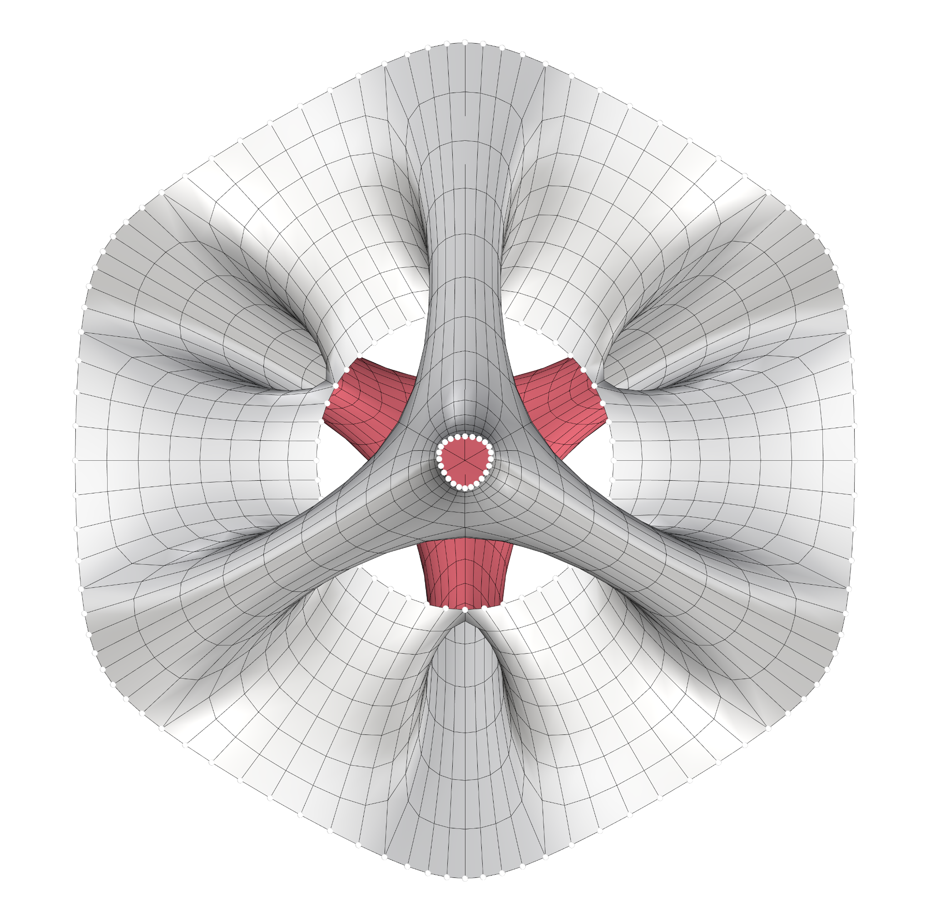
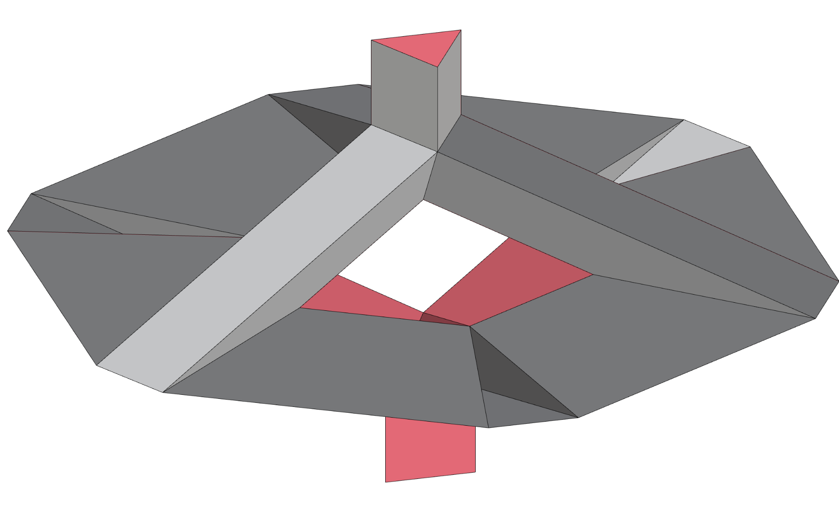
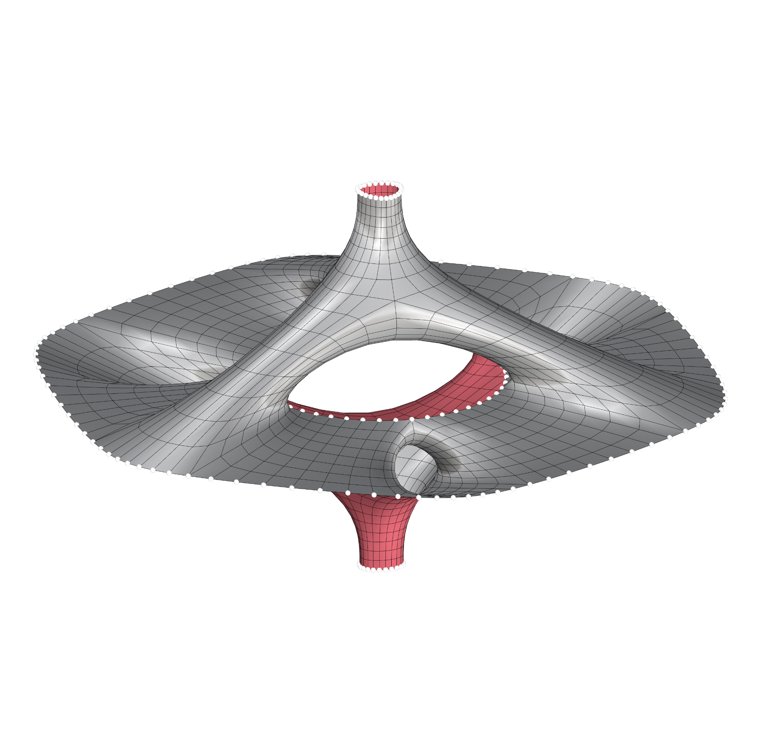
KANGAROO
CONFIGURATION
TARGET EDGE LENGTH FACTOR : 0.71
TOLERANCE : 0.001
BASE MESH
FINAL RELAXED MESH WITH ANCHOR POINTS
FINAL RELAXED MESH (TOP VIEW)

Slide 6
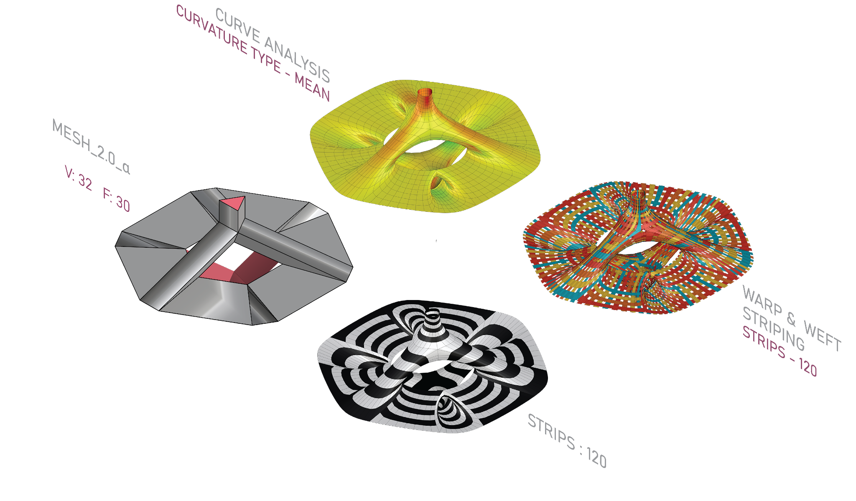
MESH TOPOLOGIES
CATMULL-CLARK SUBDIVISION CONFIGURATION:
LEVEL : 2
SMOOTH NAKED EDGES : CORNER FIXED
KANGAROO CONFIGURATION:
TARGET EDGE LENGTH FACTOR : 0.71
TOLERANCE : 0.001
OBSERVATIONS:
Controlling the initial topology by having only quad mesh faces allow for easy manipulation and organization of the strips

Slide 7
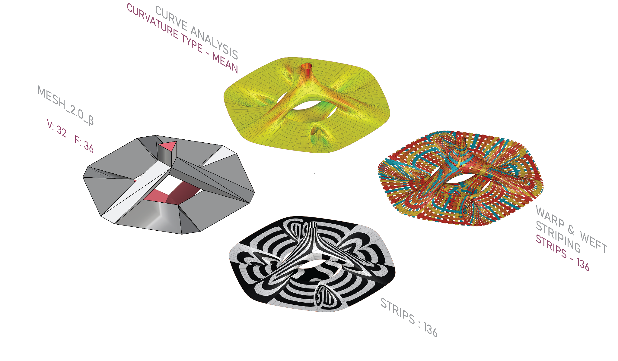
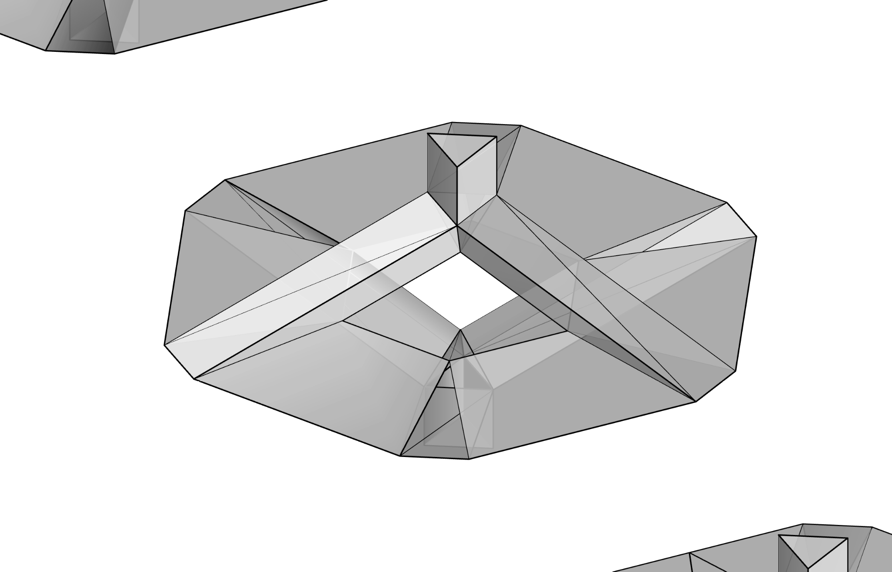
MESH TOPOLOGIES
CATMULL-CLARK SUBDIVISION CONFIGURATION:
LEVEL : 2
SMOOTH NAKED EDGES : CORNER FIXED
KANGAROO CONFIGURATION:
TARGET EDGE LENGTH FACTOR : 0.71
TOLERANCE : 0.001
OBSERVATIONS:
Beginning to divide our mesh into triangles on the tube shaped faces, we start to get interesting patterns going along those directions.
Strip number increases because triangulation breaks continuity.

Slide 8
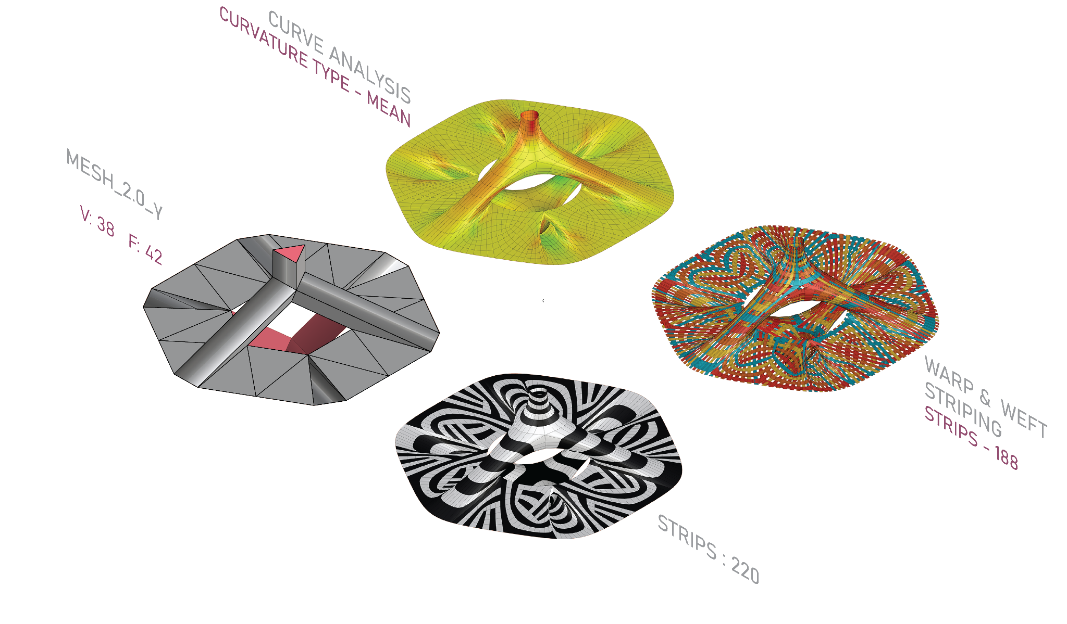
MESH TOPOLOGIES
CATMULL-CLARK SUBDIVISION CONFIGURATION:
LEVEL : 2
SMOOTH NAKED EDGES : CORNER FIXED
KANGAROO CONFIGURATION:
TARGET EDGE LENGTH FACTOR : 0.71
TOLERANCE : 0.001
OBSERVATIONS:
Increasing the number of subdivisions and triangular faces, we start having very interesting patterns.
Continuity greatly decreases and the number of stripes almost doubles.
We also start having a contrast between wide stripes where we have less initial subdivisions and thinner stripes in areas with higher subdivisions

Slide 9
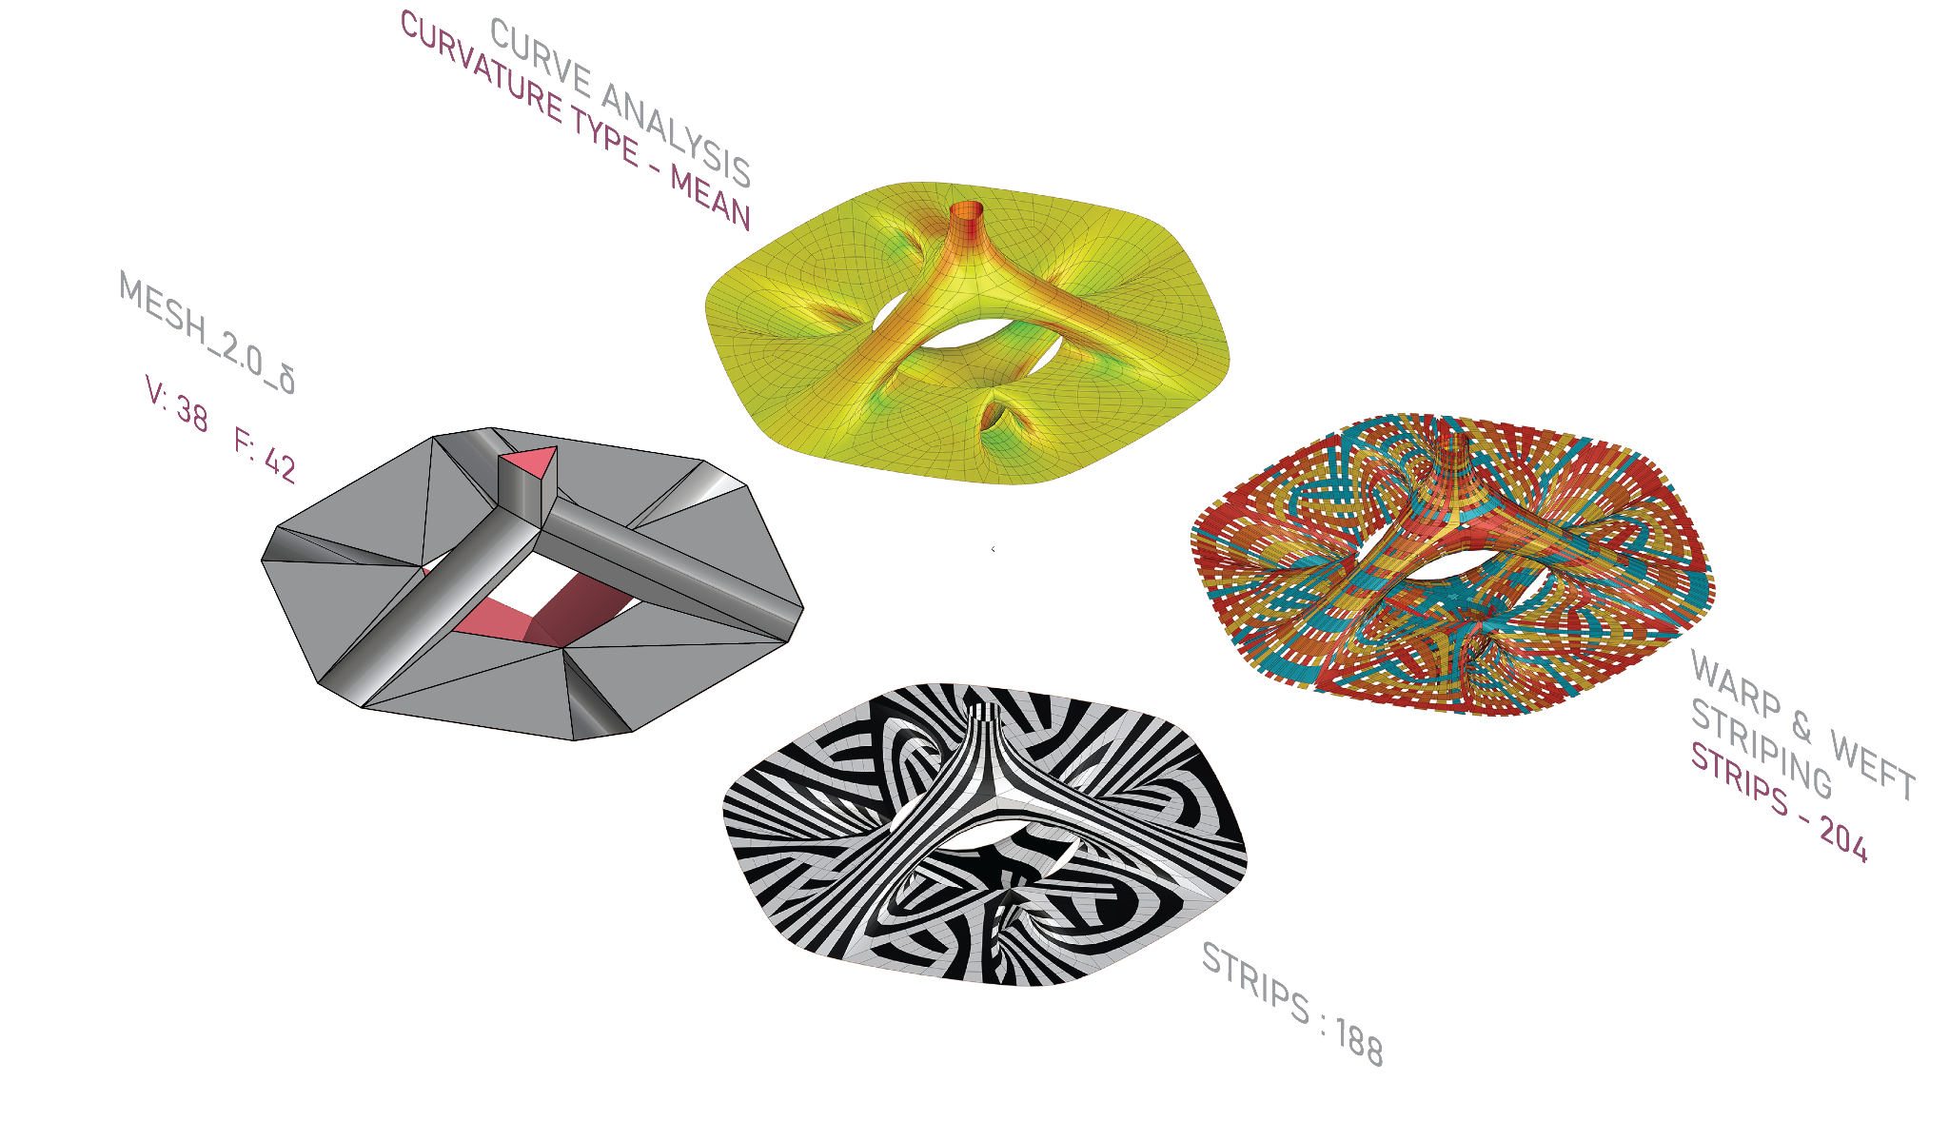
MESH TOPOLOGIES
CATMULL-CLARK SUBDIVISION CONFIGURATION:
LEVEL : 2
SMOOTH NAKED EDGES : CORNER FIXED
KANGAROO CONFIGURATION:
TARGET EDGE LENGTH FACTOR : 0.71
TOLERANCE : 0.001
OBSERVATIONS:
Dividing the larger faces, we can maintain continuity on the tube shaped faces, but start to have discontinuous patterns on the flat faces.
Strip number increases as more discontinuity is occuring.

Slide 10
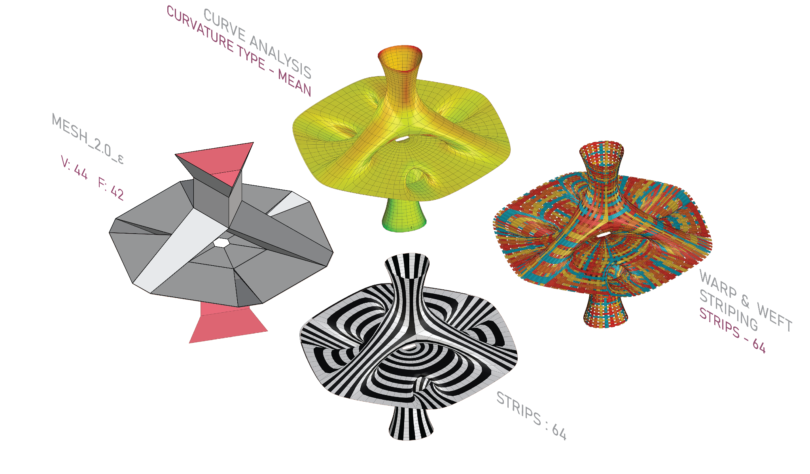
MESH TOPOLOGIES
CATMULL-CLARK SUBDIVISION CONFIGURATION:
LEVEL : 2
SMOOTH NAKED EDGES : CORNER FIXED
KANGAROO CONFIGURATION:
TARGET EDGE LENGTH FACTOR : 0.71
TOLERANCE : 0.001
OBSERVATIONS:
Adding offsets to the internal edges as well as the top and bottom faces, we can increase the surface area and get more repetition.
Despite having a larger surface area, orienting the faces to be more linear, we get very high continuity and the number of strips drops dramatically to 64, but strip length also increases.

Slide 11
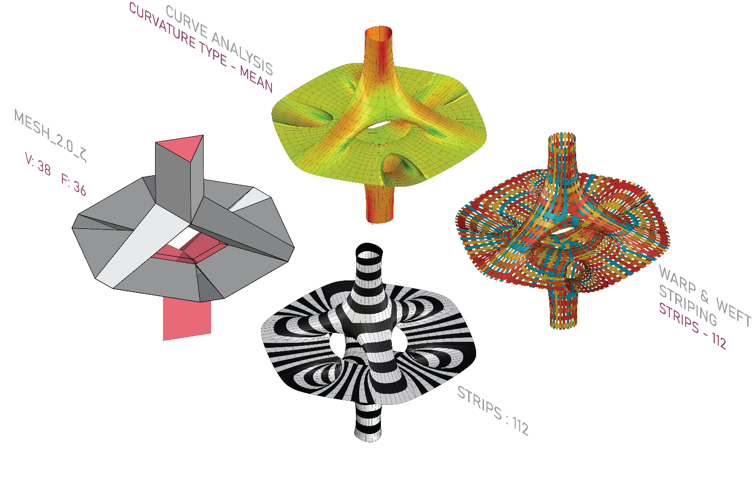
MESH TOPOLOGIES
CATMULL-CLARK SUBDIVISION CONFIGURATION:
LEVEL : 2
SMOOTH NAKED EDGES : CORNER FIXED
KANGAROO CONFIGURATION:
TARGET EDGE LENGTH FACTOR : 0.71
TOLERANCE : 0.001
OBSERVATIONS:
With wider tubular faces, and a bigger top and bottom, we can achieve a more desirable stable structure.
Retaining only quad faces, we are able to organize the strips with ease for fabrication.

Slide 12
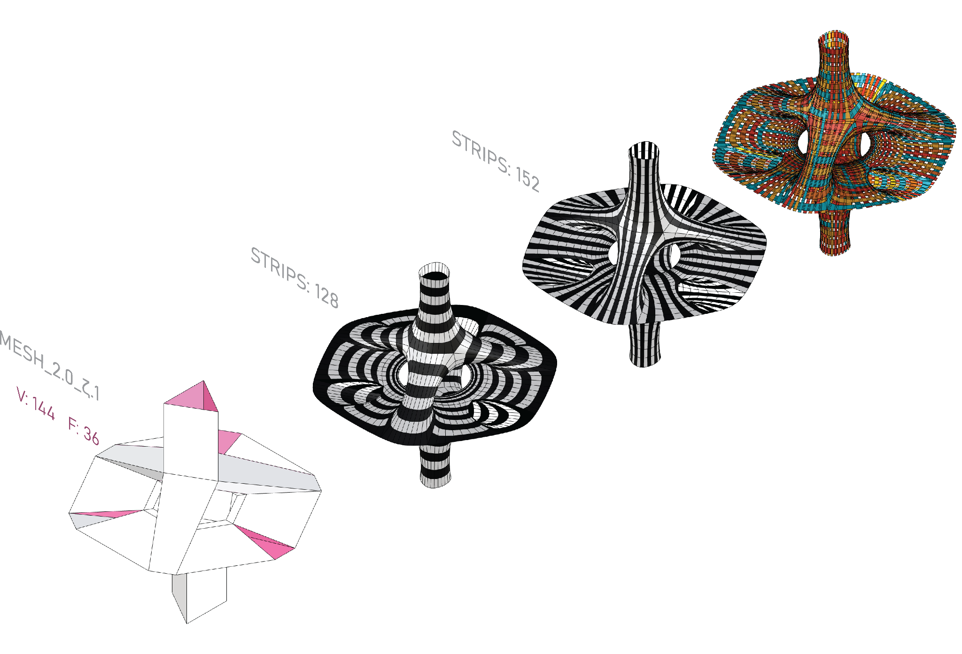
MESH FACE TOPOLOGIES
CATMULL-CLARK SUBDIVISION CONFIGURATION:
LEVEL : 2
SMOOTH NAKED EDGES : CORNER FIXED
KANGAROO CONFIGURATION:
TARGET EDGE LENGTH FACTOR : 0.71
TOLERANCE : 0.001
OBSERVATIONS:
Maintaining all quad faces, we obtain a relatively high number of strips when strips are all oriented in the same direction, due to the discontinuities created because of the irregularity of the geometry.

Slide 13
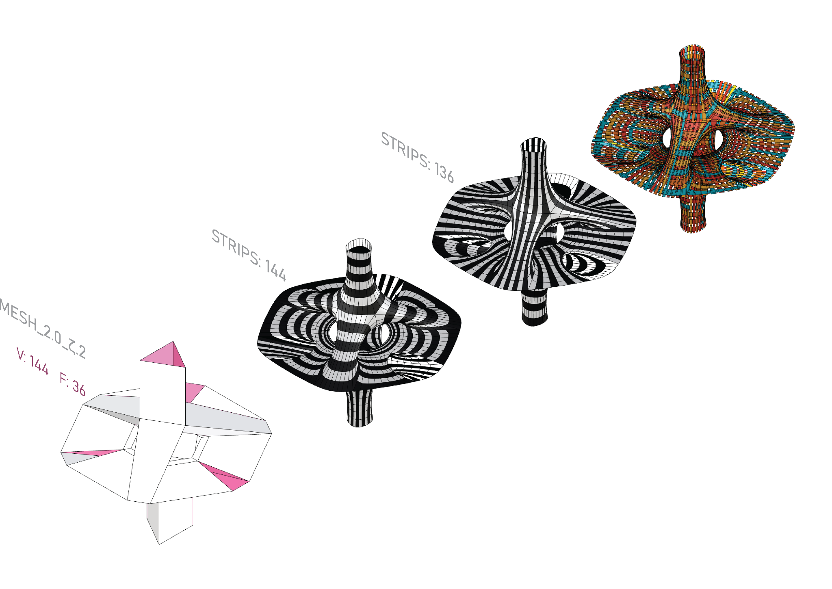
MESH FACE TOPOLOGIES
CATMULL-CLARK SUBDIVISION CONFIGURATION:
LEVEL : 2
SMOOTH NAKED EDGES : CORNER FIXED
KANGAROO CONFIGURATION:
TARGET EDGE LENGTH FACTOR : 0.71
TOLERANCE : 0.001
OBSERVATIONS:
Having the top with circular looped faces, while the bottom has stripes, creates a nice contrast, but maintains similar strip quantities.

Slide 14
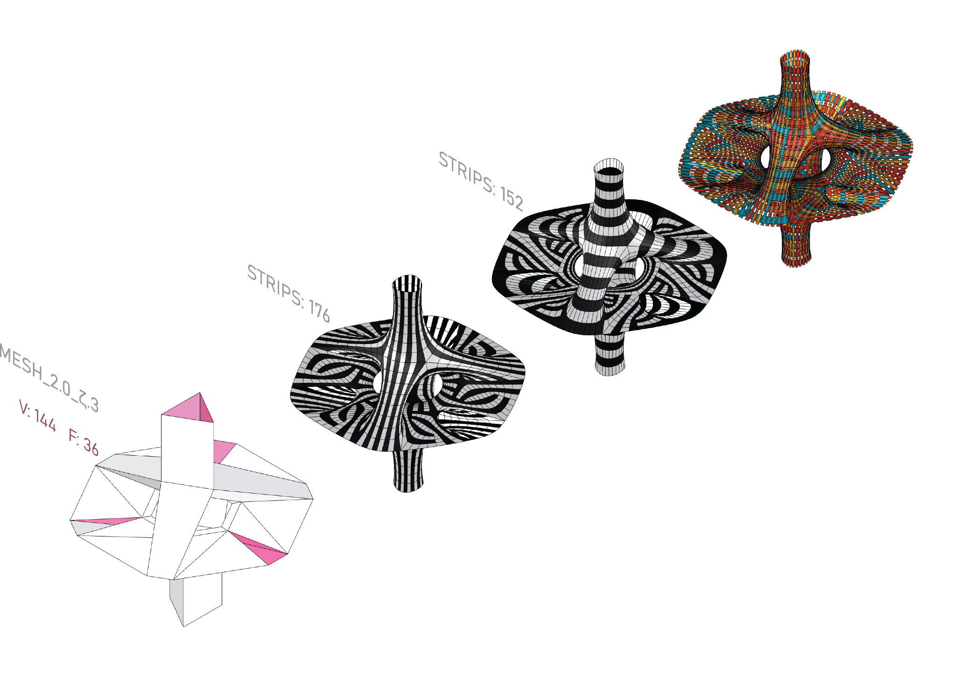
MESH FACE TOPOLOGIES
CATMULL-CLARK SUBDIVISION CONFIGURATION:
LEVEL : 2
SMOOTH NAKED EDGES : CORNER FIXED
KANGAROO CONFIGURATION:
TARGET EDGE LENGTH FACTOR : 0.71
TOLERANCE : 0.001
OBSERVATIONS:
Dividing faces with a script, we start to have nice patterns in our exploration for symmetric and manufacturable strips,
Low continuity here means a higher number of strips.

Slide 15
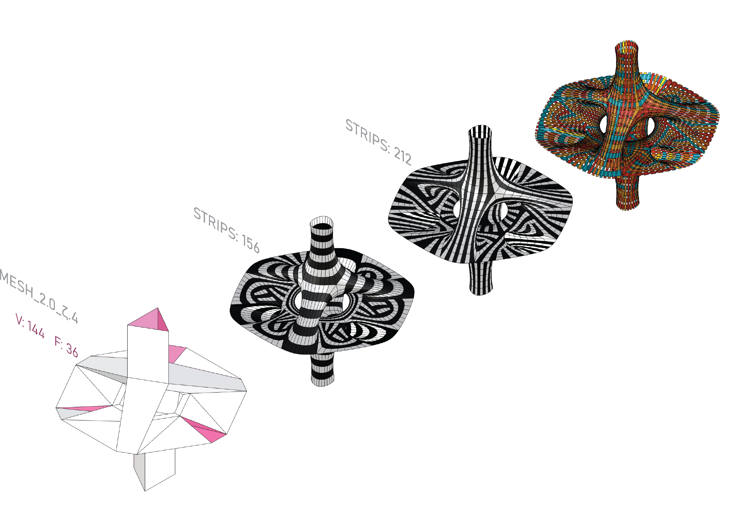
MESH FACE TOPOLOGIES
CATMULL-CLARK SUBDIVISION CONFIGURATION:
LEVEL : 2
SMOOTH NAKED EDGES : CORNER FIXED
KANGAROO CONFIGURATION:
TARGET EDGE LENGTH FACTOR : 0.71
TOLERANCE : 0.001
OBSERVATIONS:
Keeping the same subdivisions, but rotating the faces, we can achieve a higher number of strips.

Slide 16
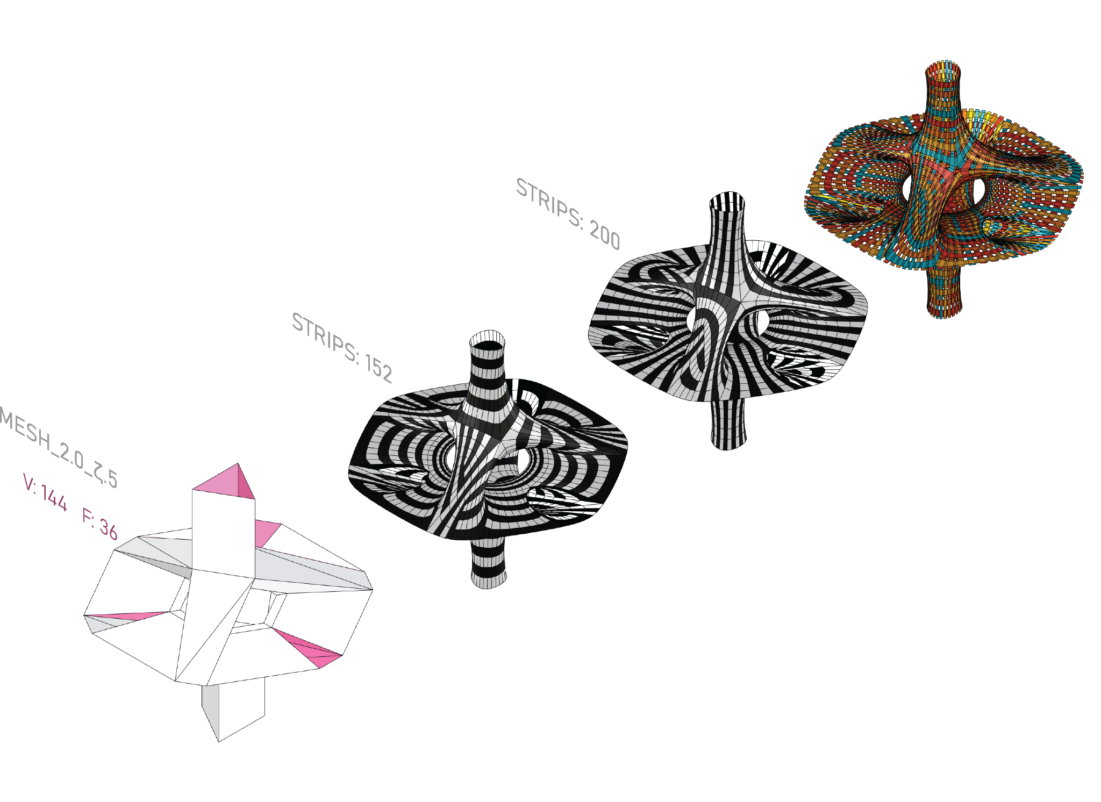
MESH FACE TOPOLOGIES
CATMULL-CLARK SUBDIVISION CONFIGURATION:
LEVEL : 2
SMOOTH NAKED EDGES : CORNER FIXED
KANGAROO CONFIGURATION:
TARGET EDGE LENGTH FACTOR : 0.71
TOLERANCE : 0.001
OBSERVATIONS:
Dividing the tubular faces, we get alot of discontinuity on the curved surfaces., which would not be desirable in manufacturing.

Slide 17
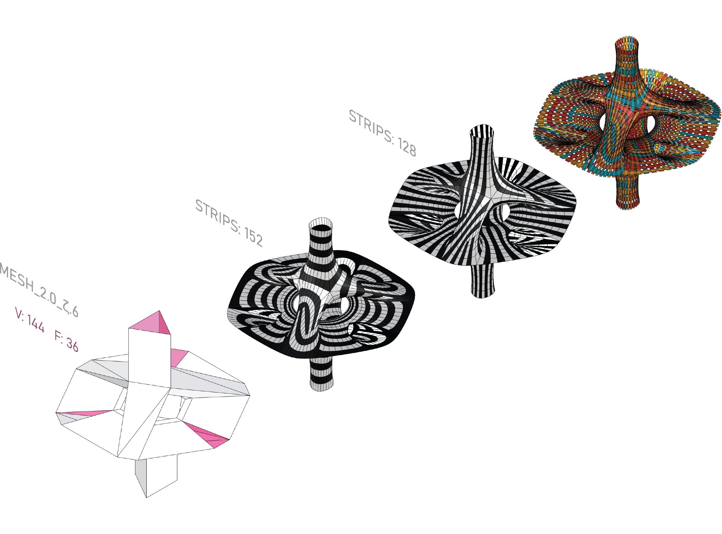
MESH
FACE TOPOLOGIES
CATMULL-CLARK SUBDIVISION CONFIGURATION:
LEVEL : 2
SMOOTH NAKED EDGES : CORNER FIXED
KANGAROO CONFIGURATION:
TARGET EDGE LENGTH FACTOR : 0.71
TOLERANCE : 0.001
OBSERVATIONS:
Rotating the faces, we have a cleaner pattern with higher continuity.

Slide 18
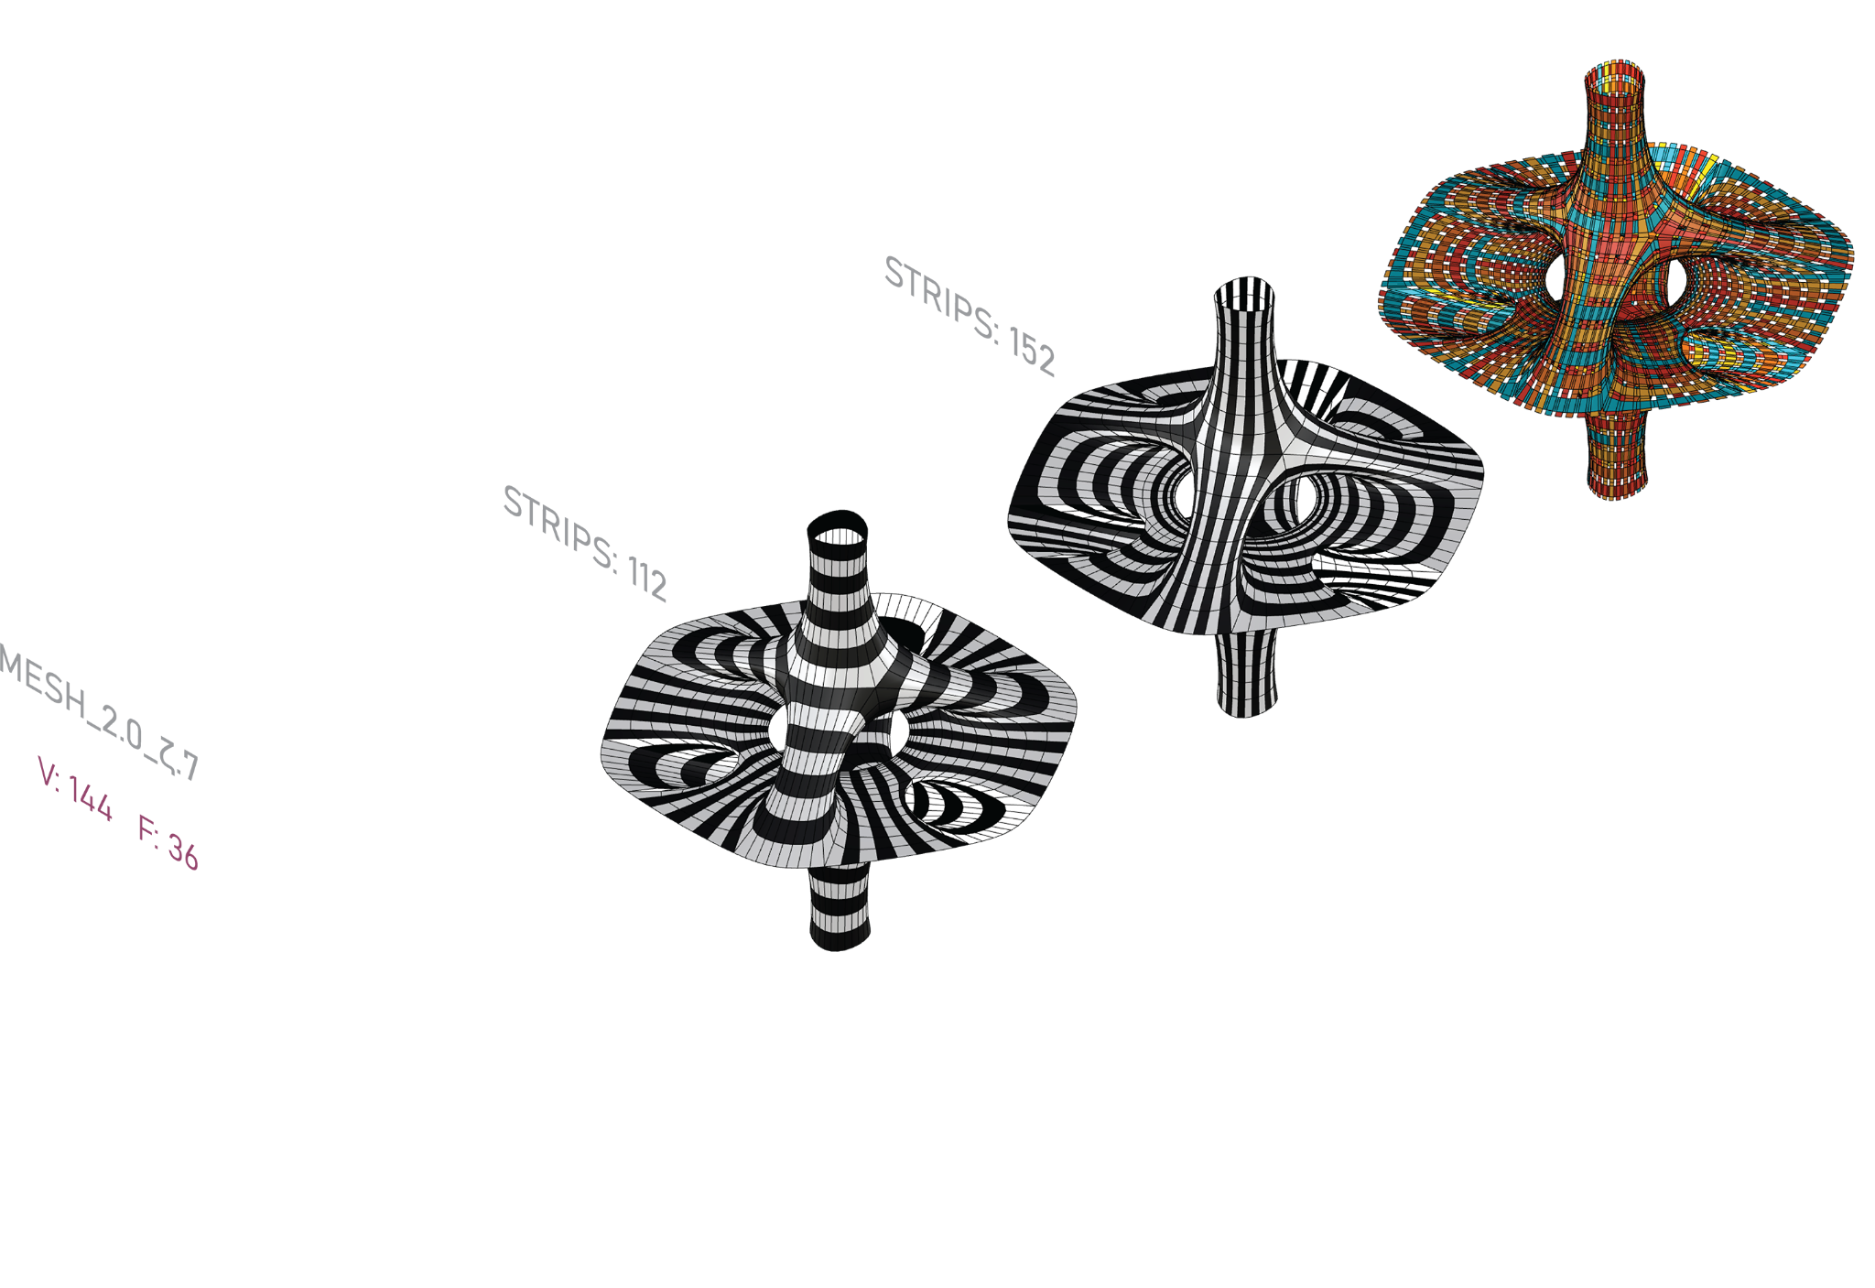
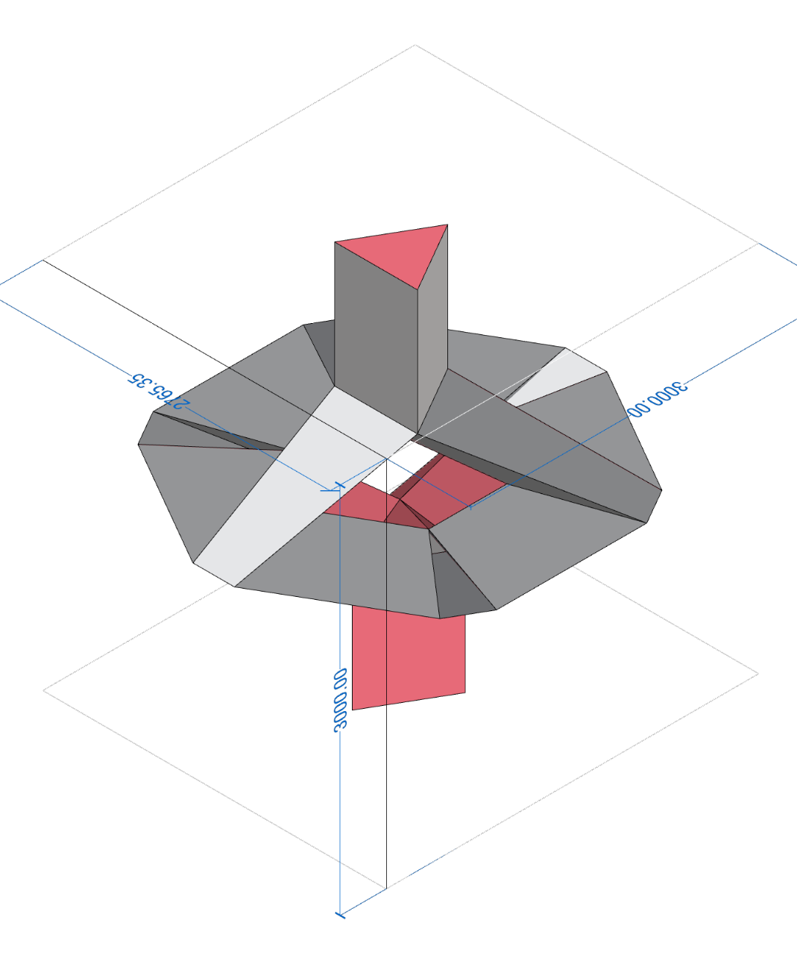
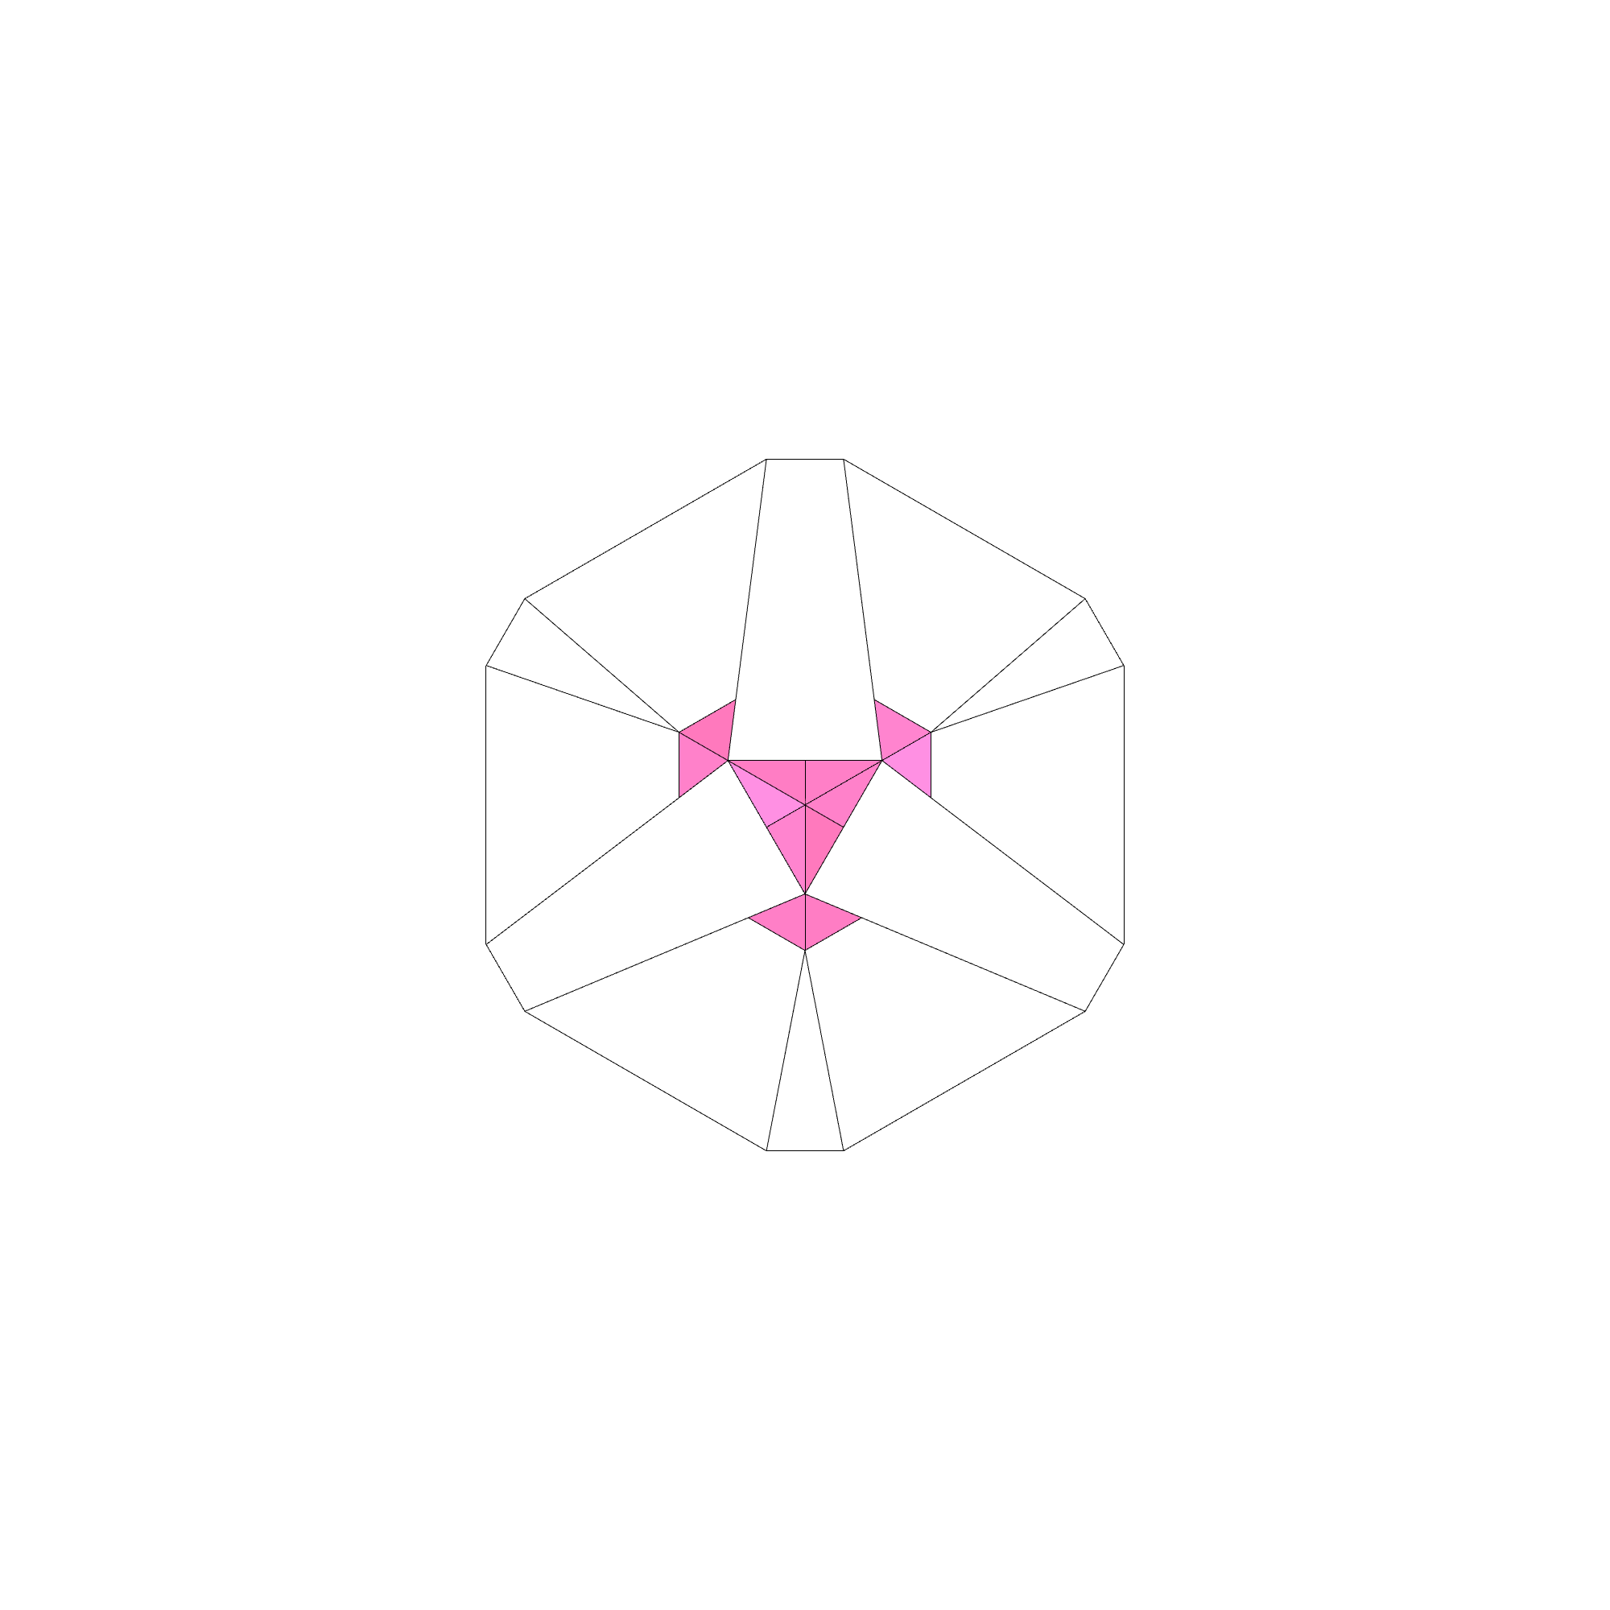
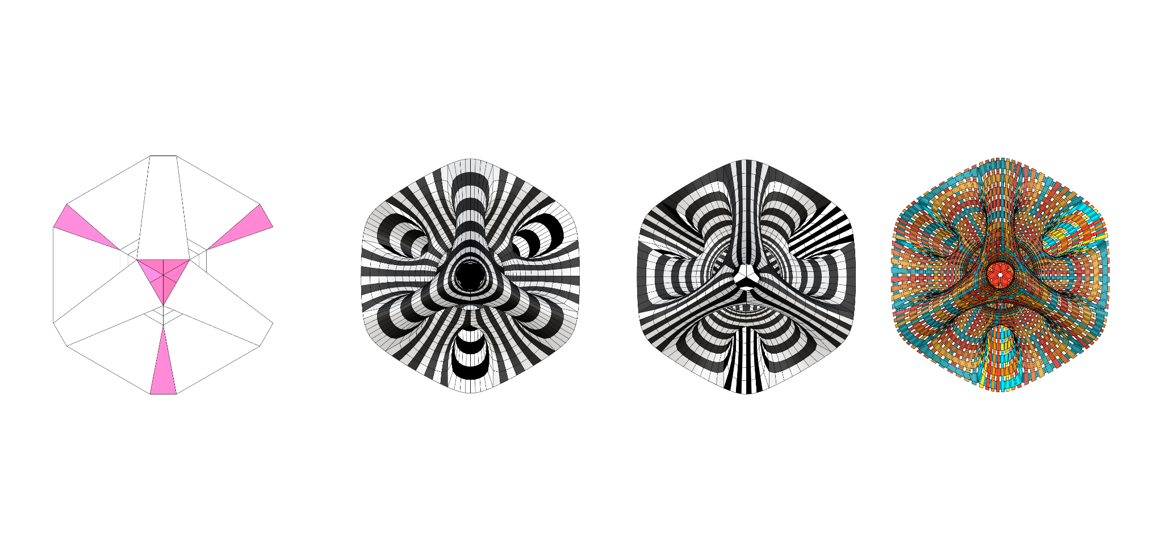
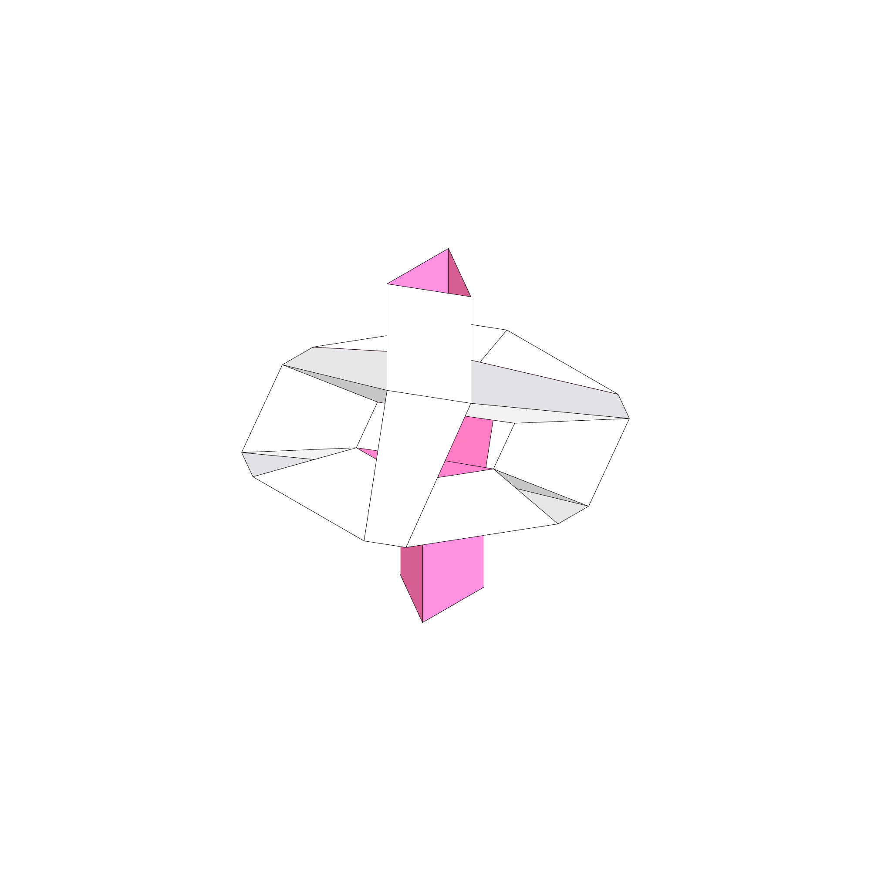
MESH
FACE TOPOLOGIES
CATMULL-CLARK SUBDIVISION CONFIGURATION:
LEVEL : 2
SMOOTH NAKED EDGES : CORNER FIXED
KANGAROO CONFIGURATION:
TARGET EDGE LENGTH FACTOR : 0.71
TOLERANCE : 0.001

Slide 19
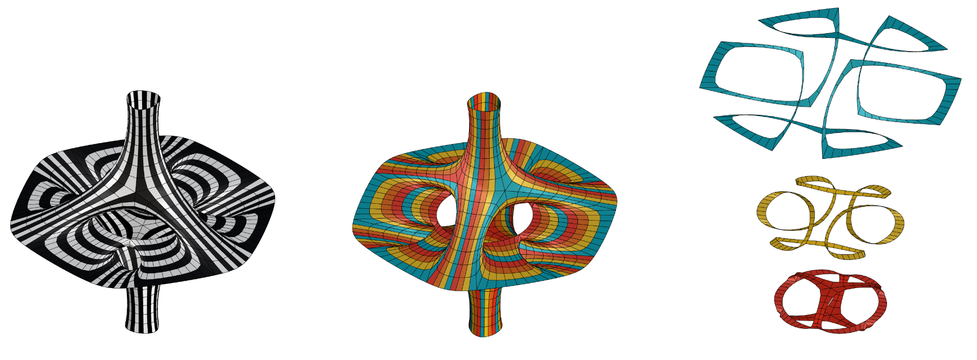
MESH CONSIDERATIONS
OBSERVATIONS:
Least amount of loops due to the extremely high level of continuity that was achieved.
Continuity also meant,long closed loops difficult for fabrication with traditional laser cutters.
Total Strips: 56
Open: 48
Closed: 8

Slide 20
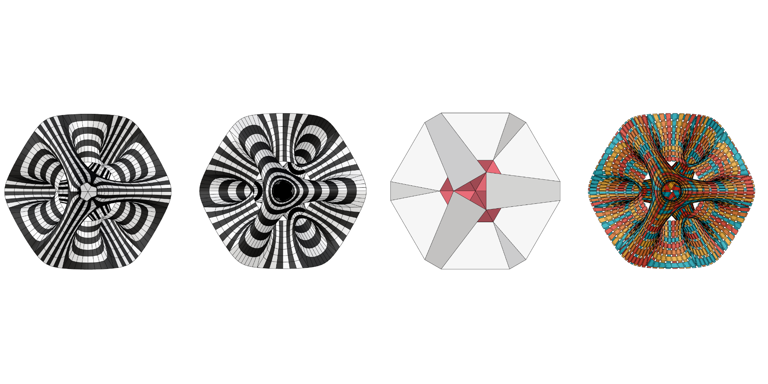
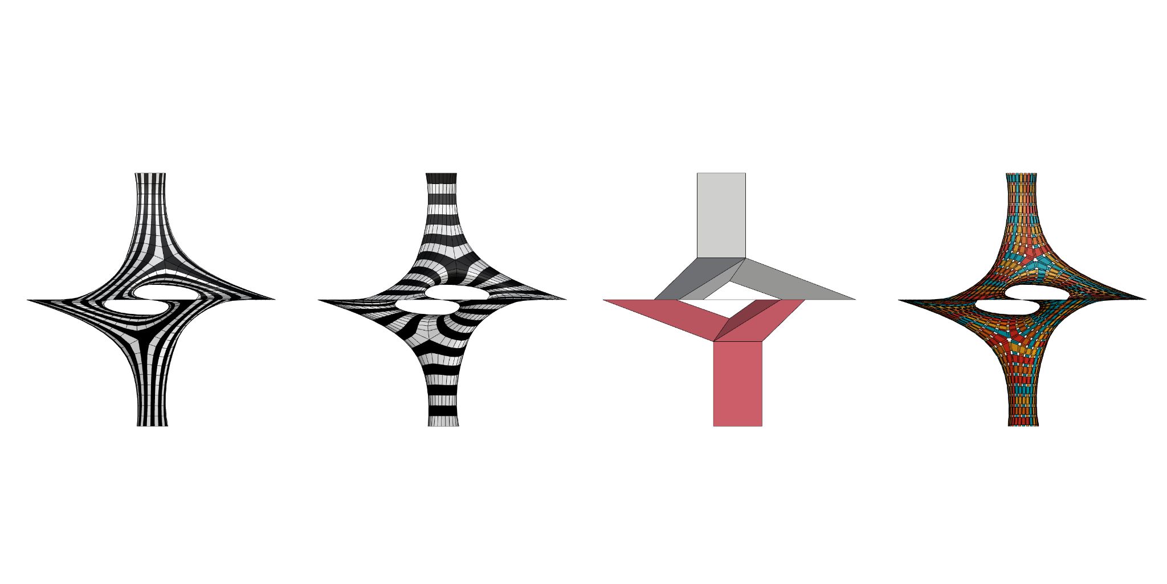
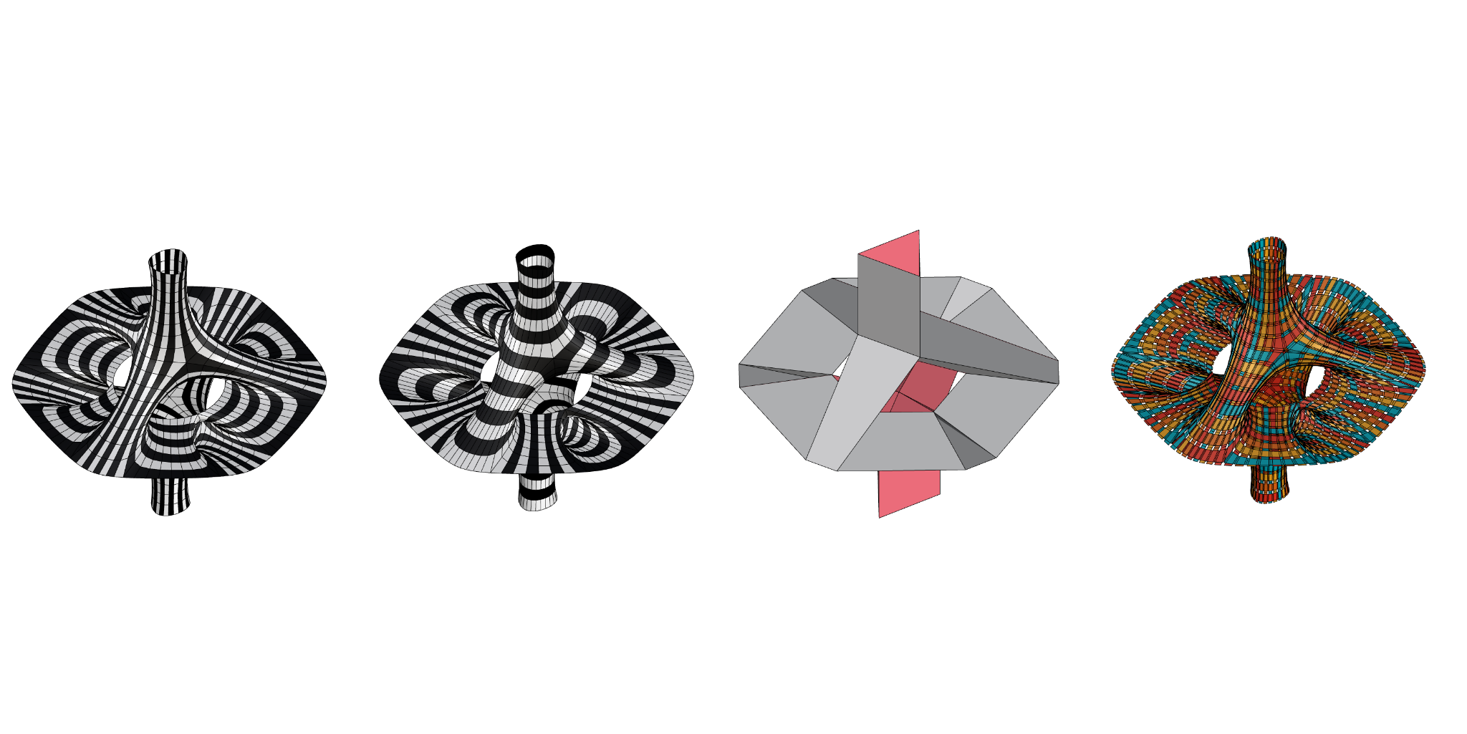
FINAL MESH ITERATION
CATMULL-CLARK SUBDIVISION CONFIGURATION:
LEVEL : 2
SMOOTH NAKED EDGES : CORNER FIXED
KANGAROO CONFIGURATION:
TARGET EDGE LENGTH FACTOR : 0.71
TOLERANCE : 0.001
Total Strips: 56
Open: 48
Closed: 8
Total Strips: 112
Open: 48
Closed: 64

Slide 21
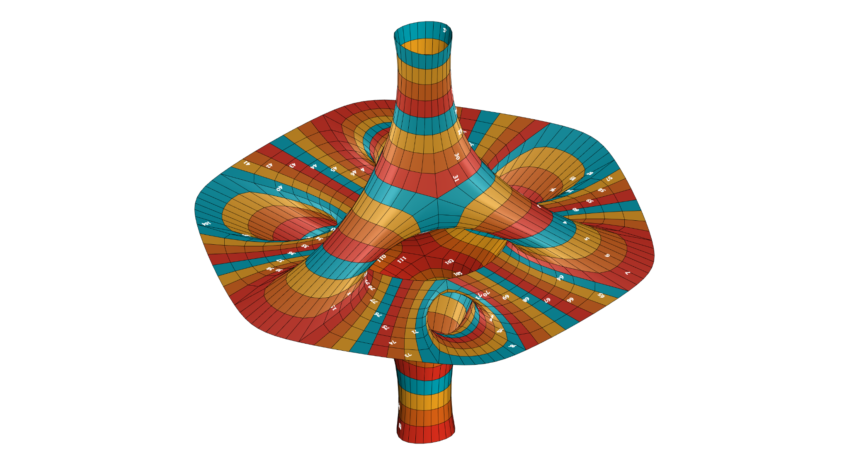
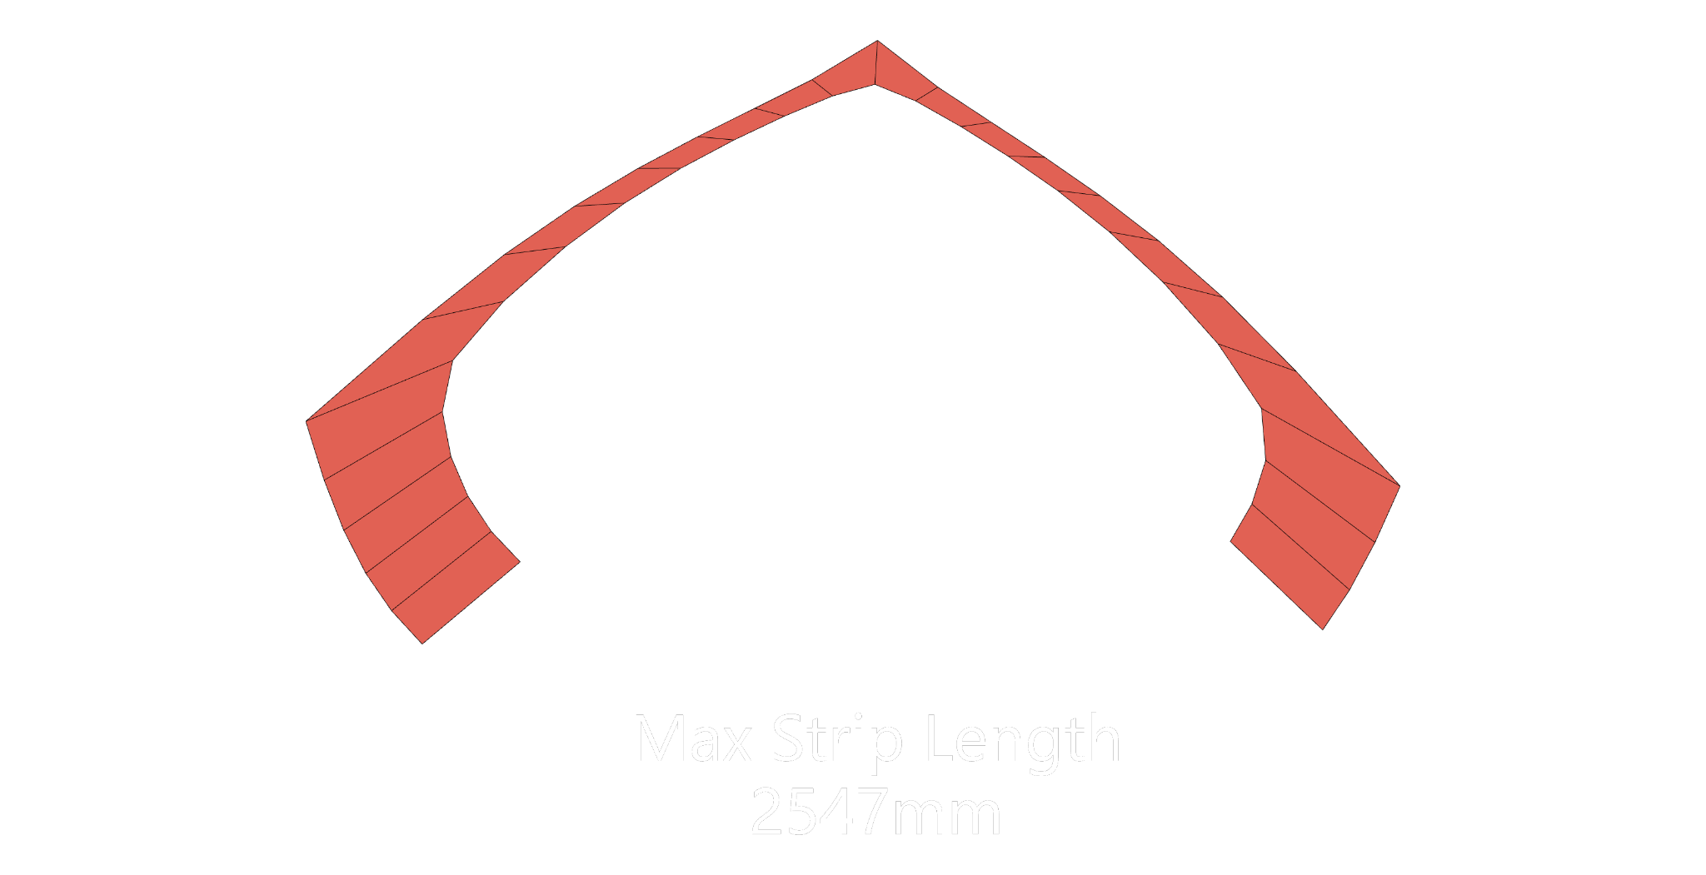
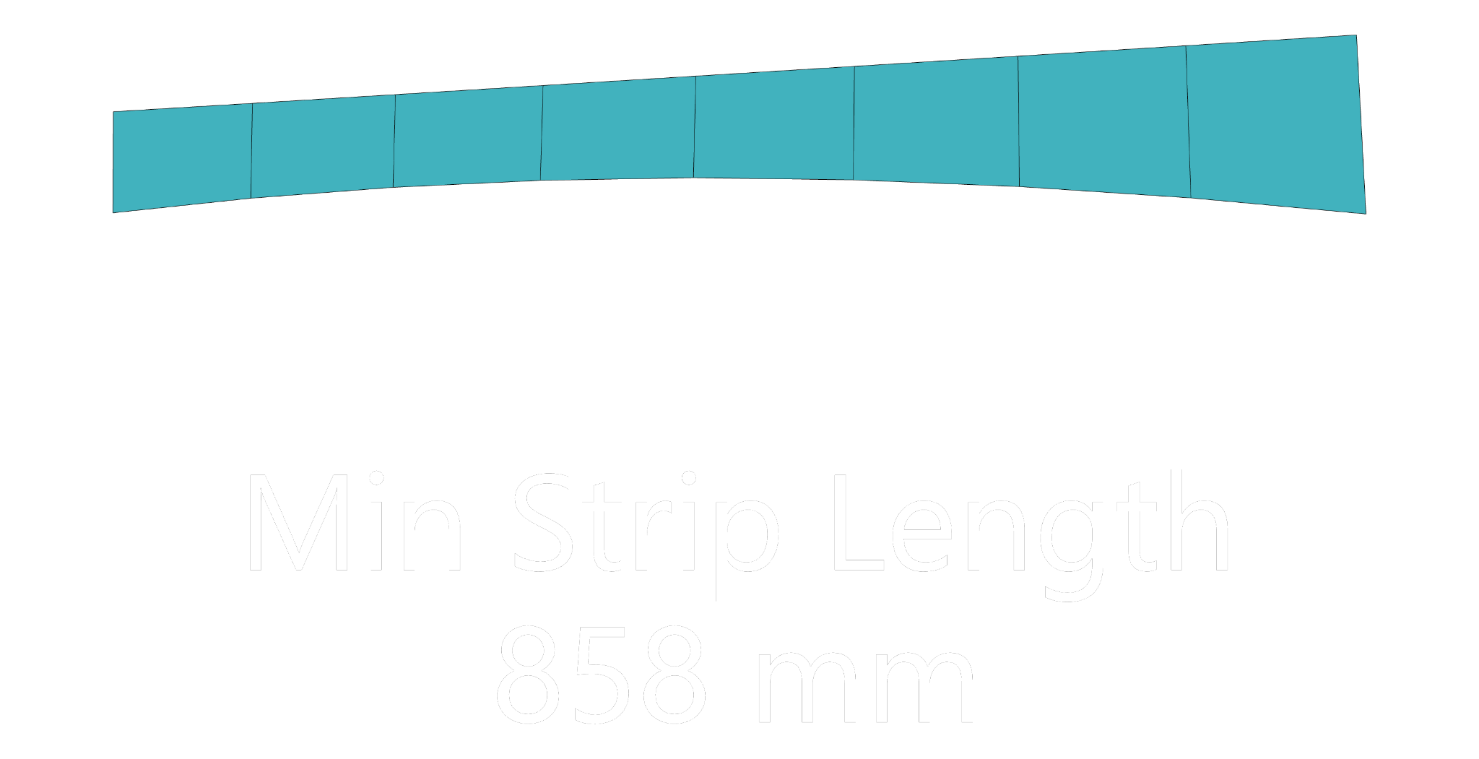
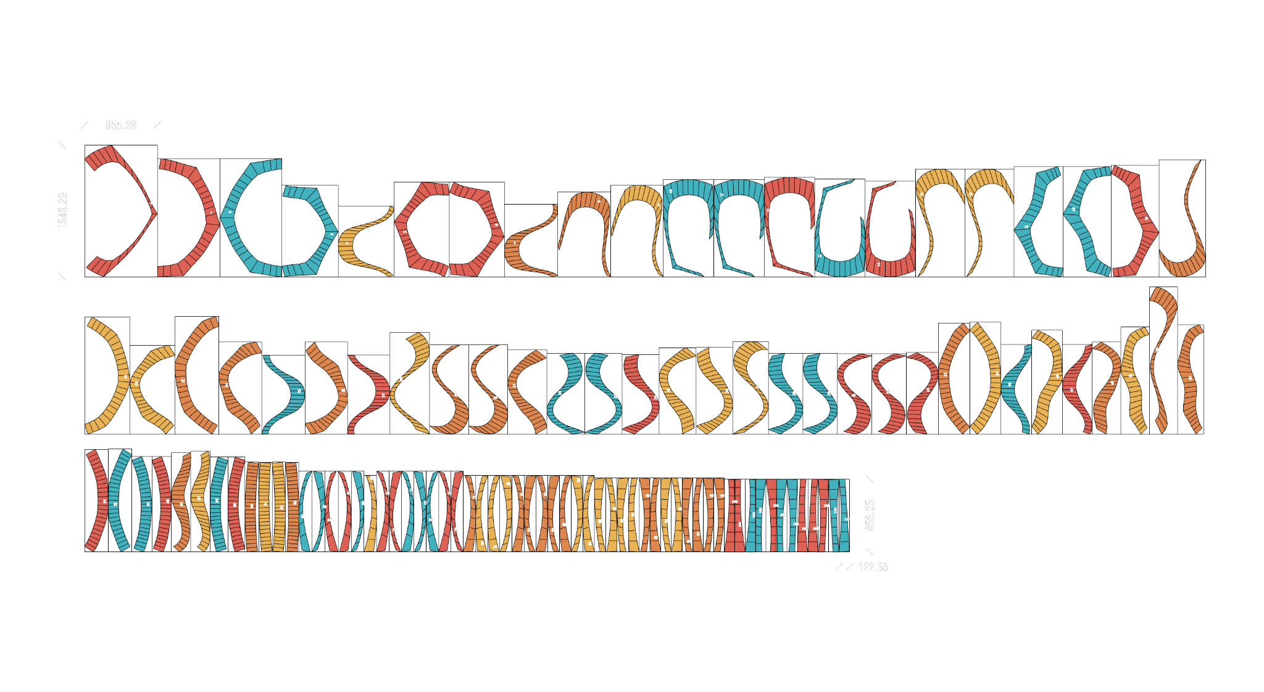
UNROLLING
UNROLLED STRIPS FOR LASER CUTTING

Slide 22
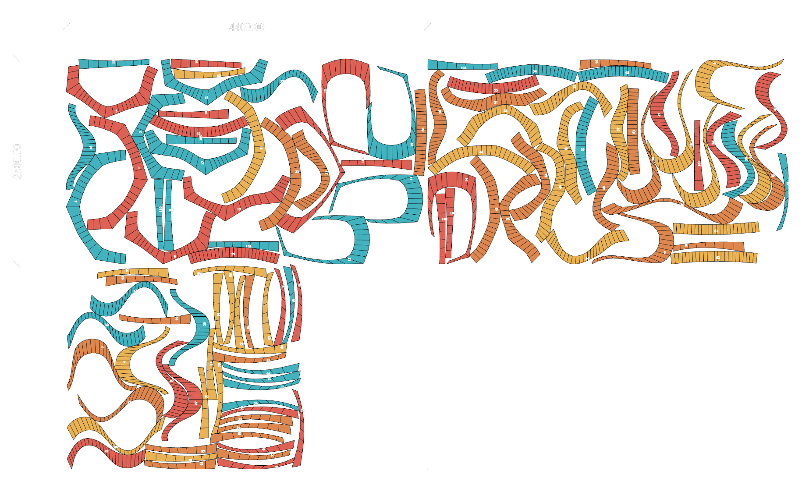
NESTING FOR FABRICATION
UNROLLED STRIPS FOR LASER CUTTING
GWEIKE LF3015LN - FIBER LASER CUTTING MACHINE
BED SIZE: 4400 X 2500 mm
3 Sheets Needed

Slide 23
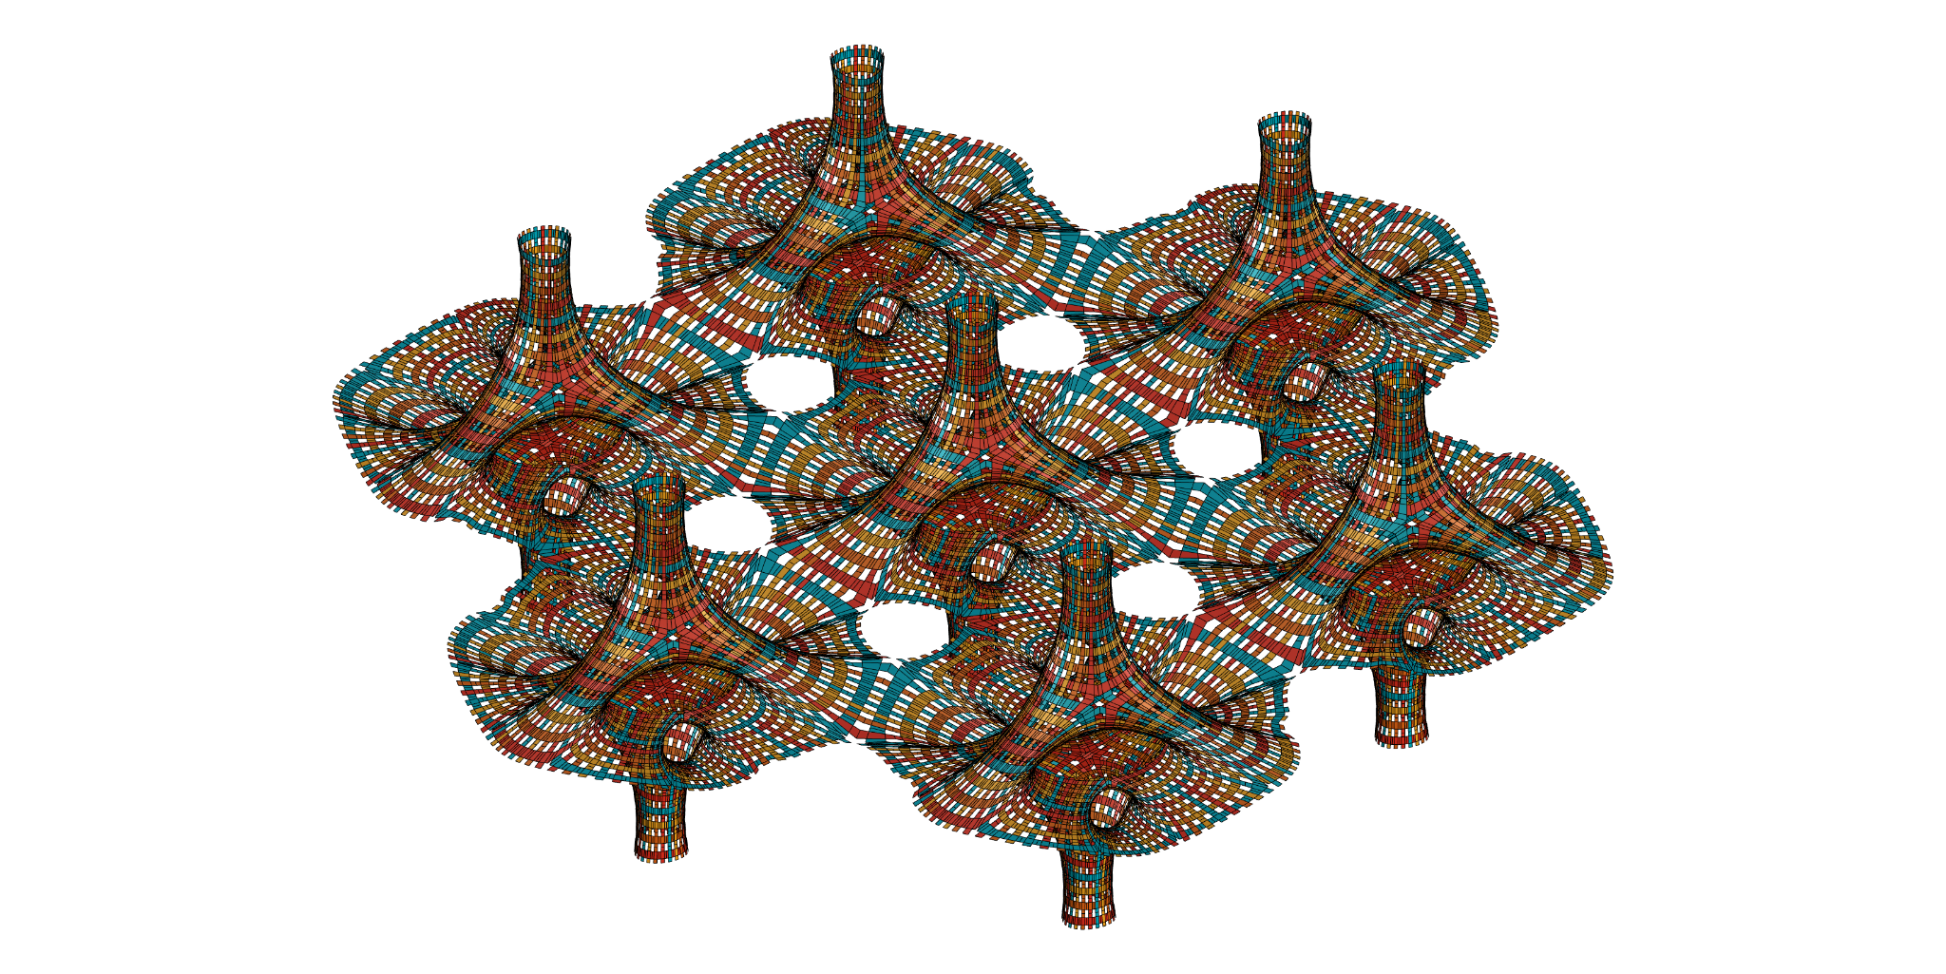
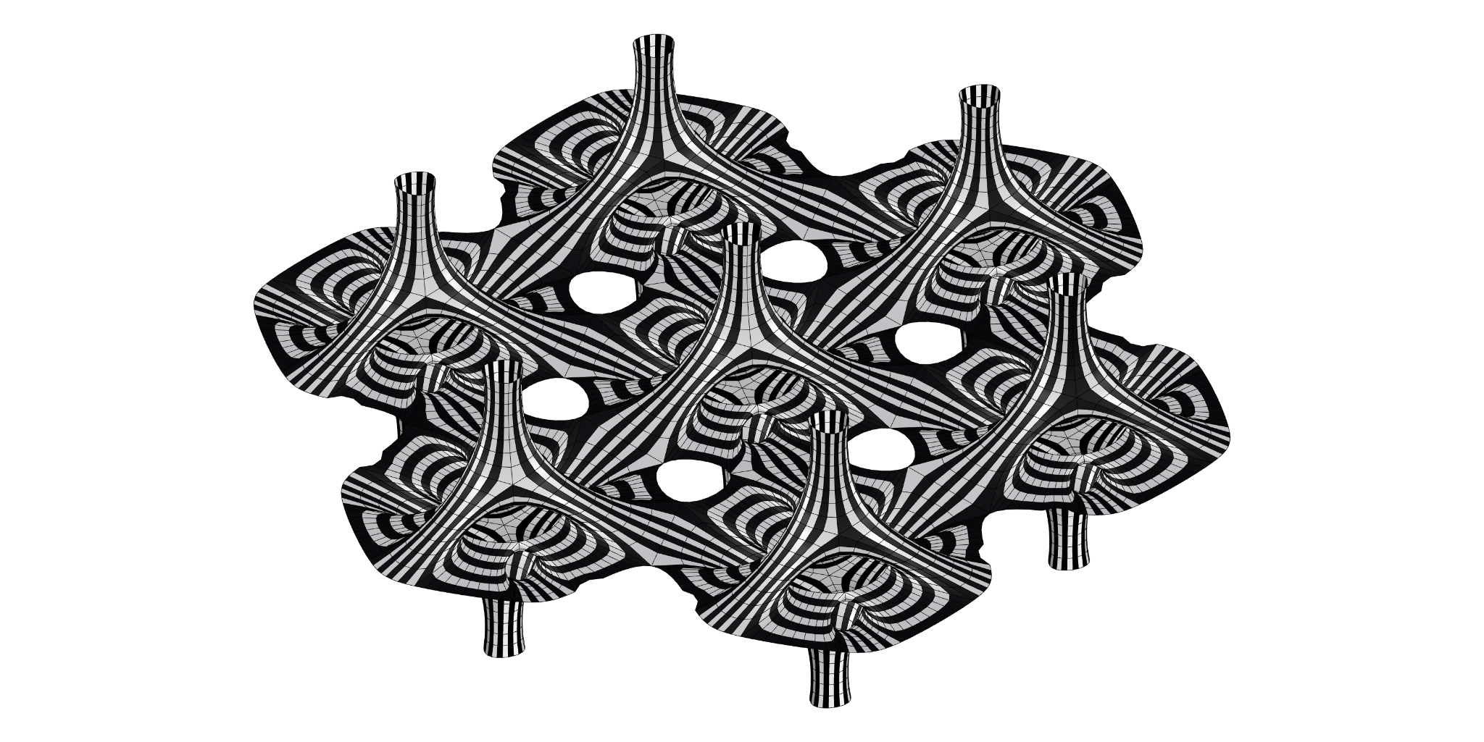
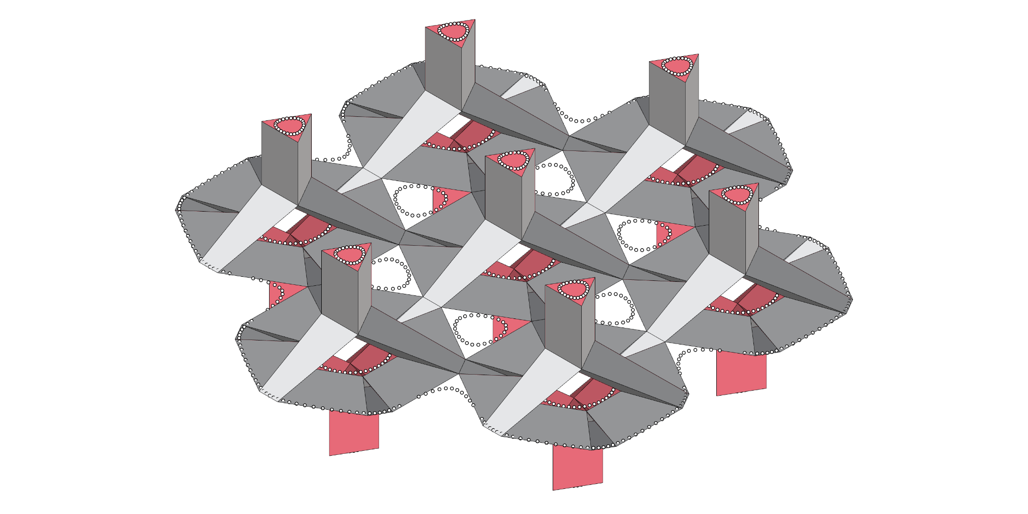
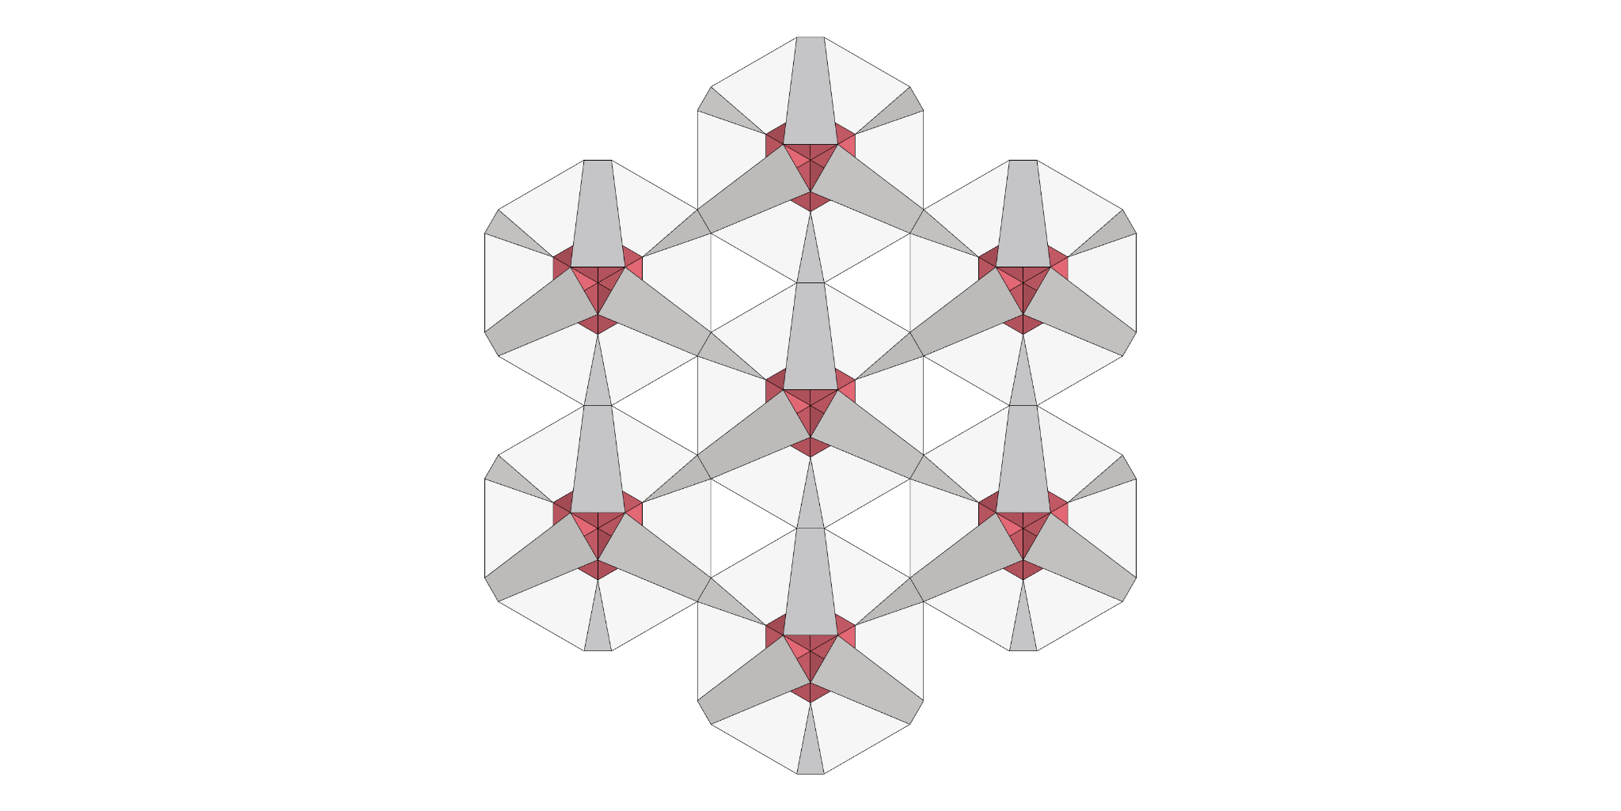
GOING FURTHER
CONNECTIONS AT SHORT NAKED EDGES

Slide 24


MeX_PRIMER

Slide 25
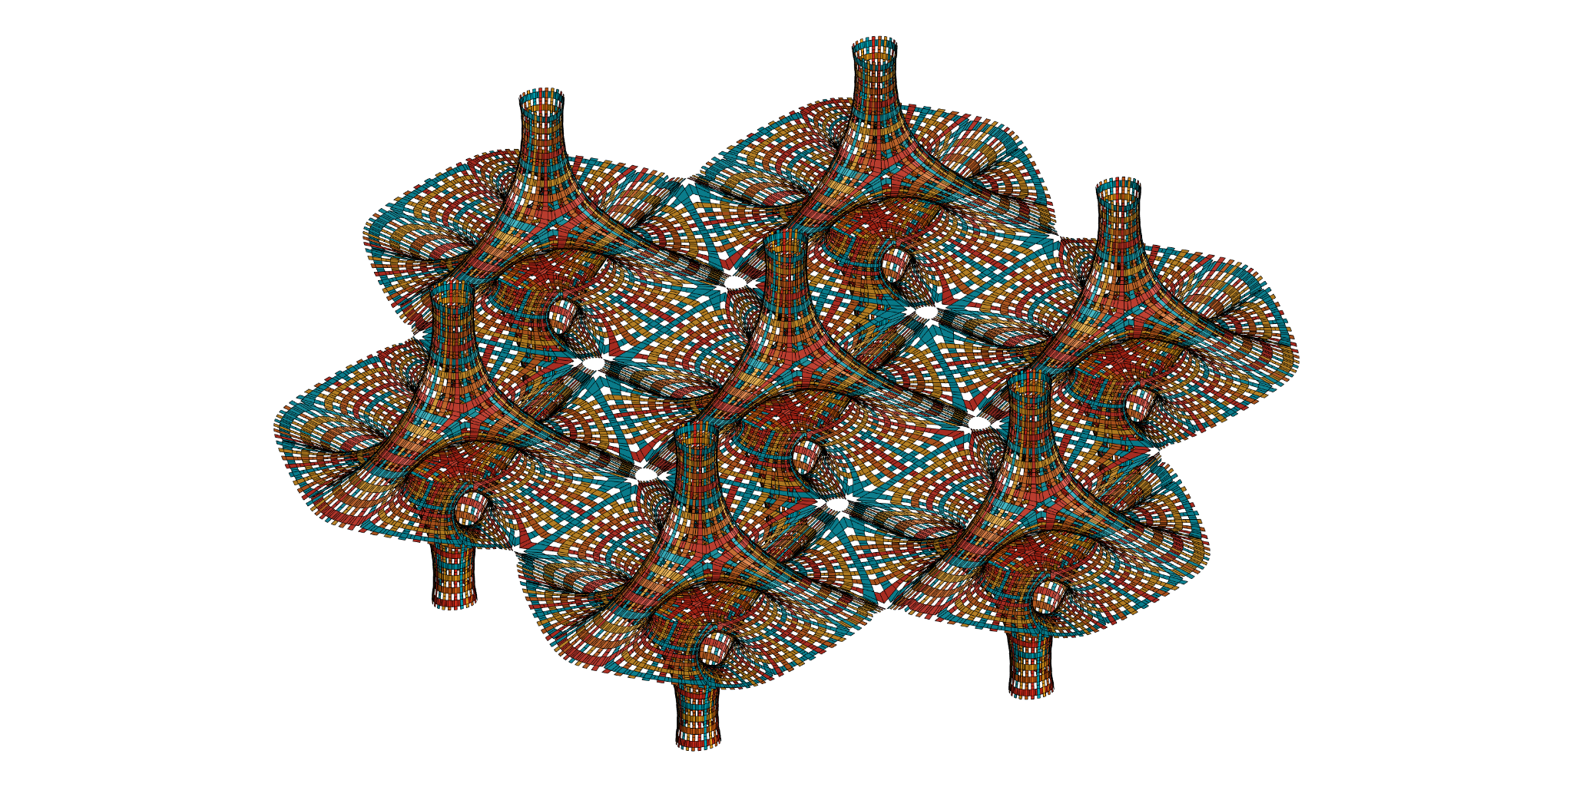
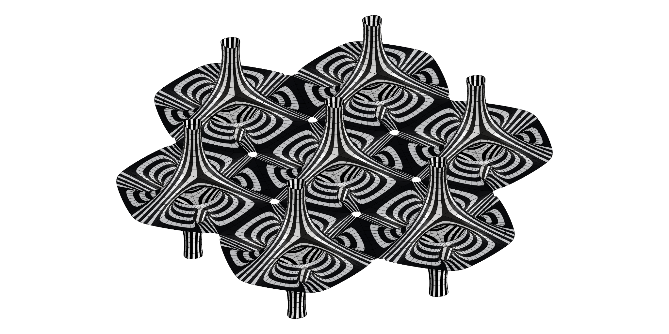
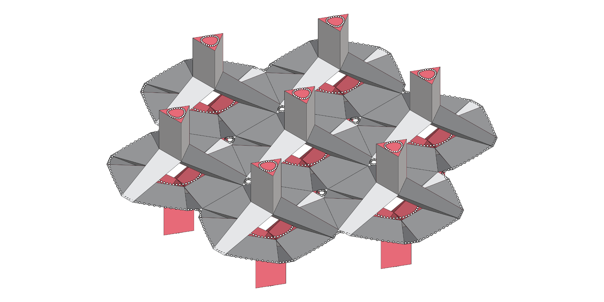
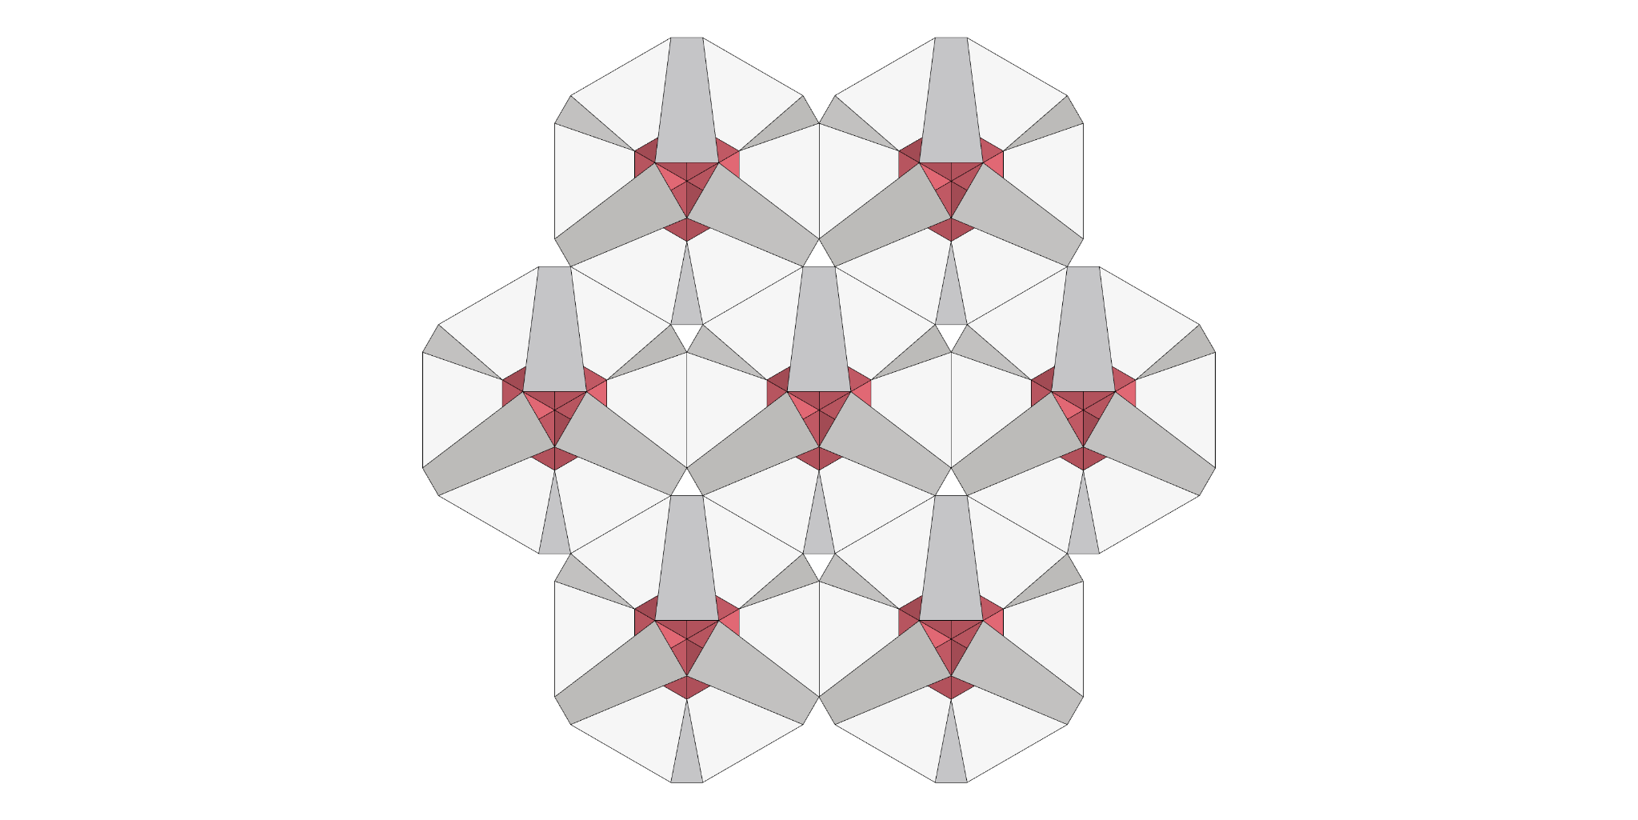
GOING FURTHER
CONNECTIONS AT LONG NAKED EDGES

Slide 26
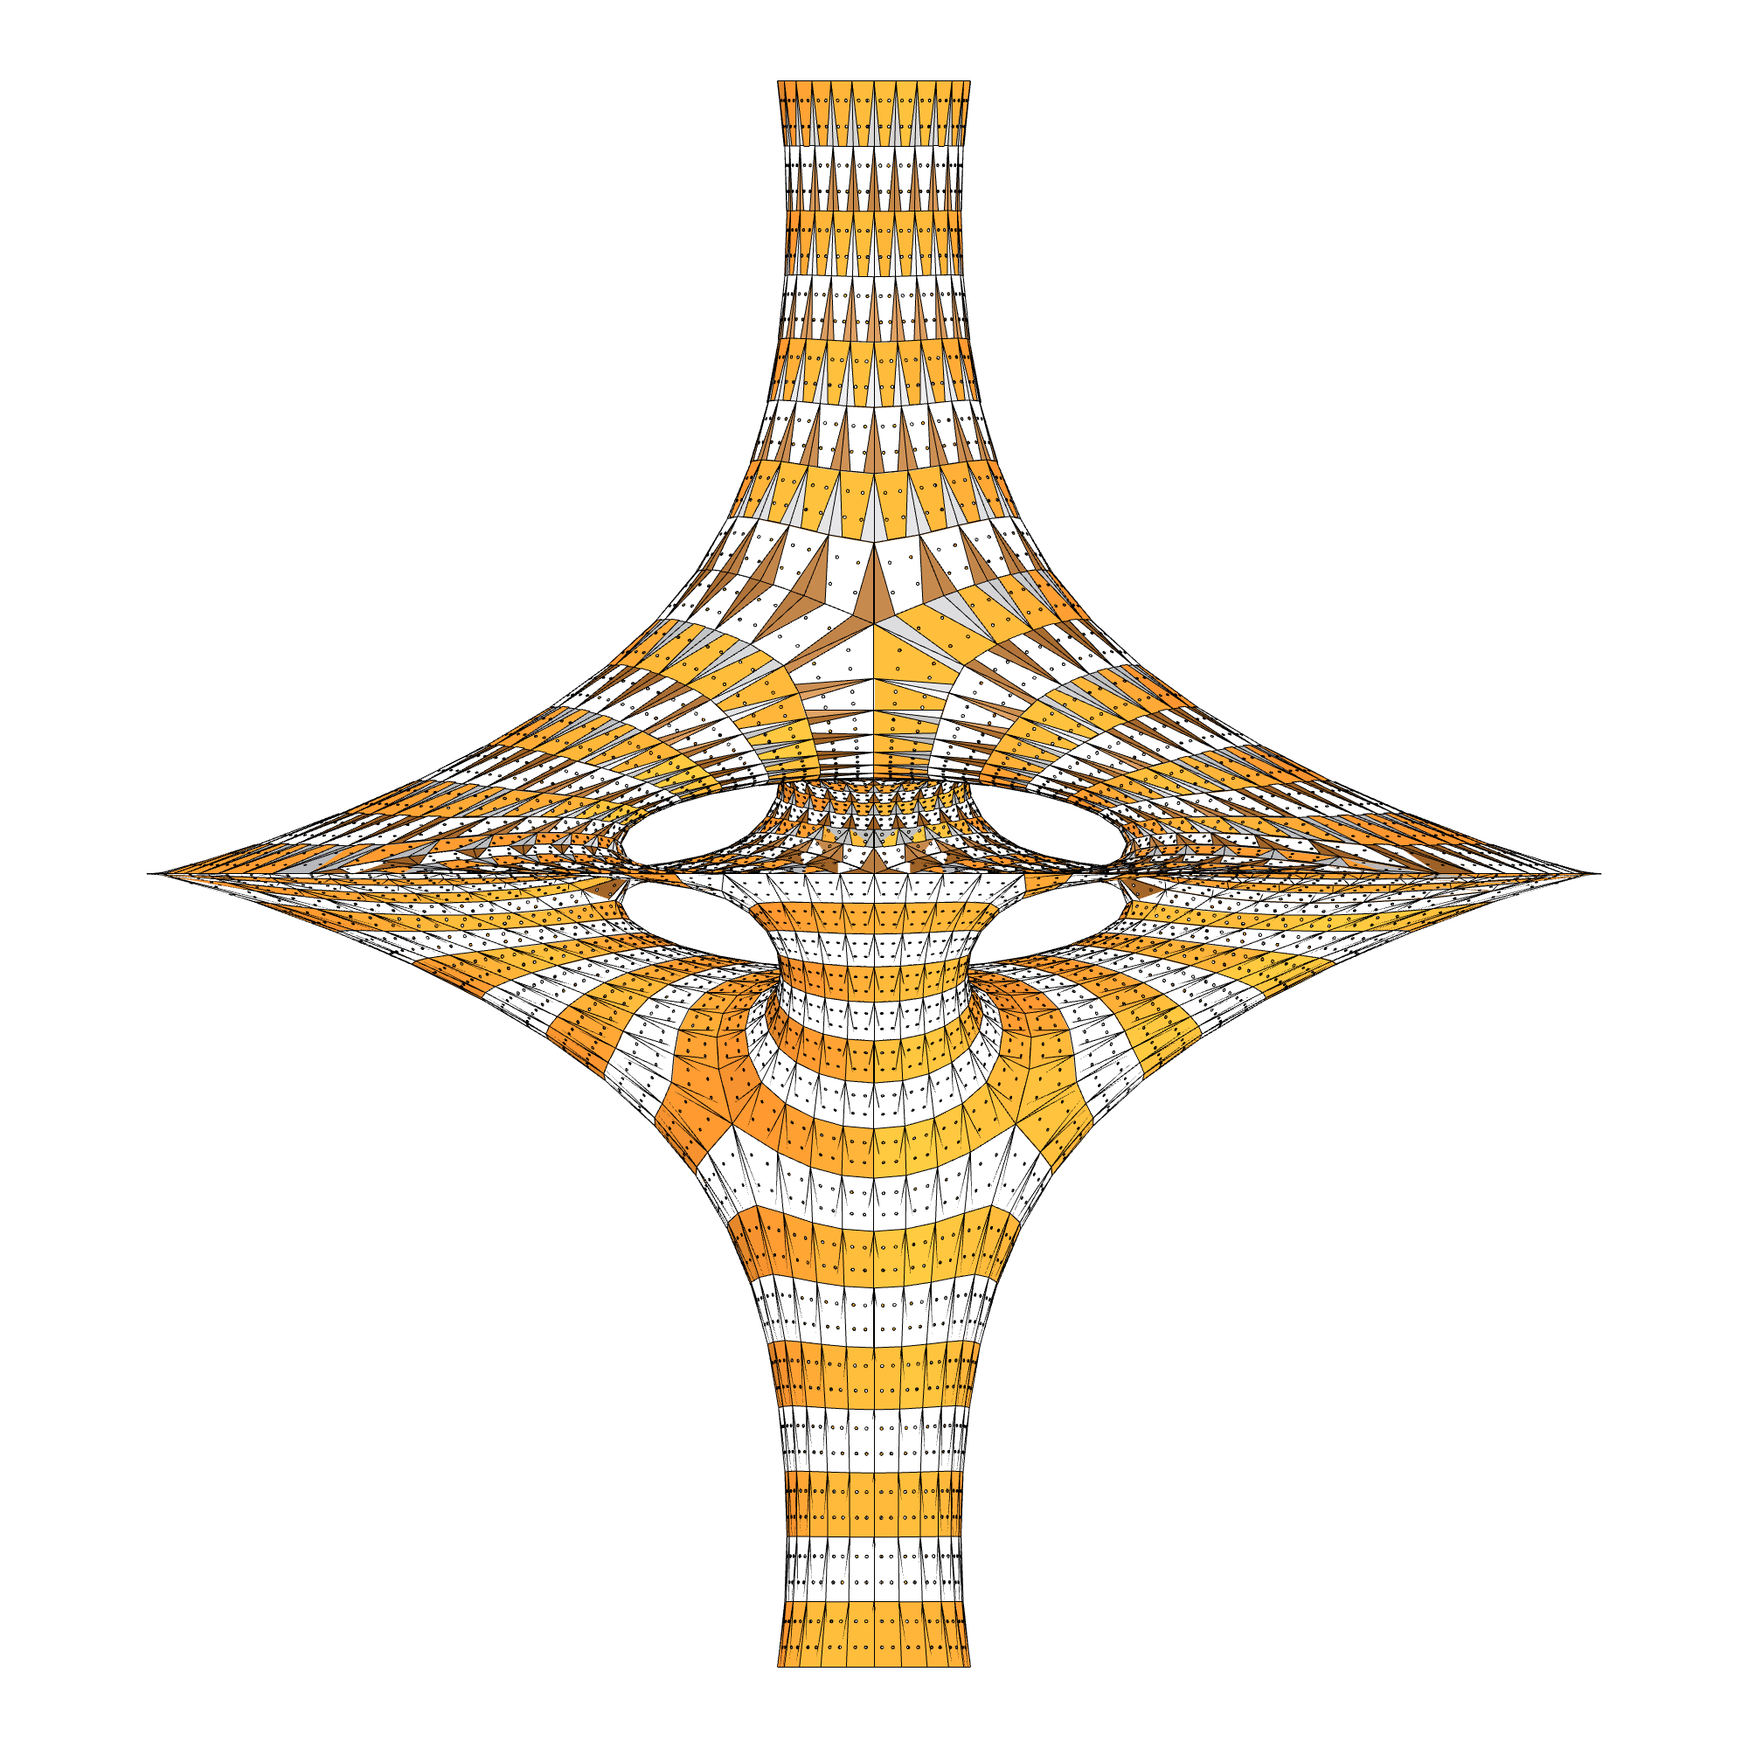
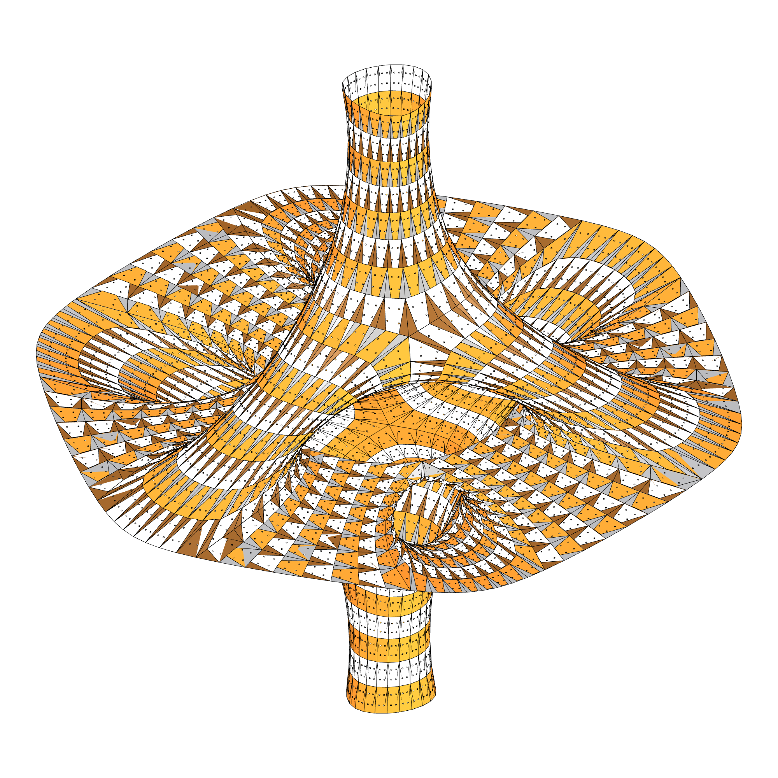
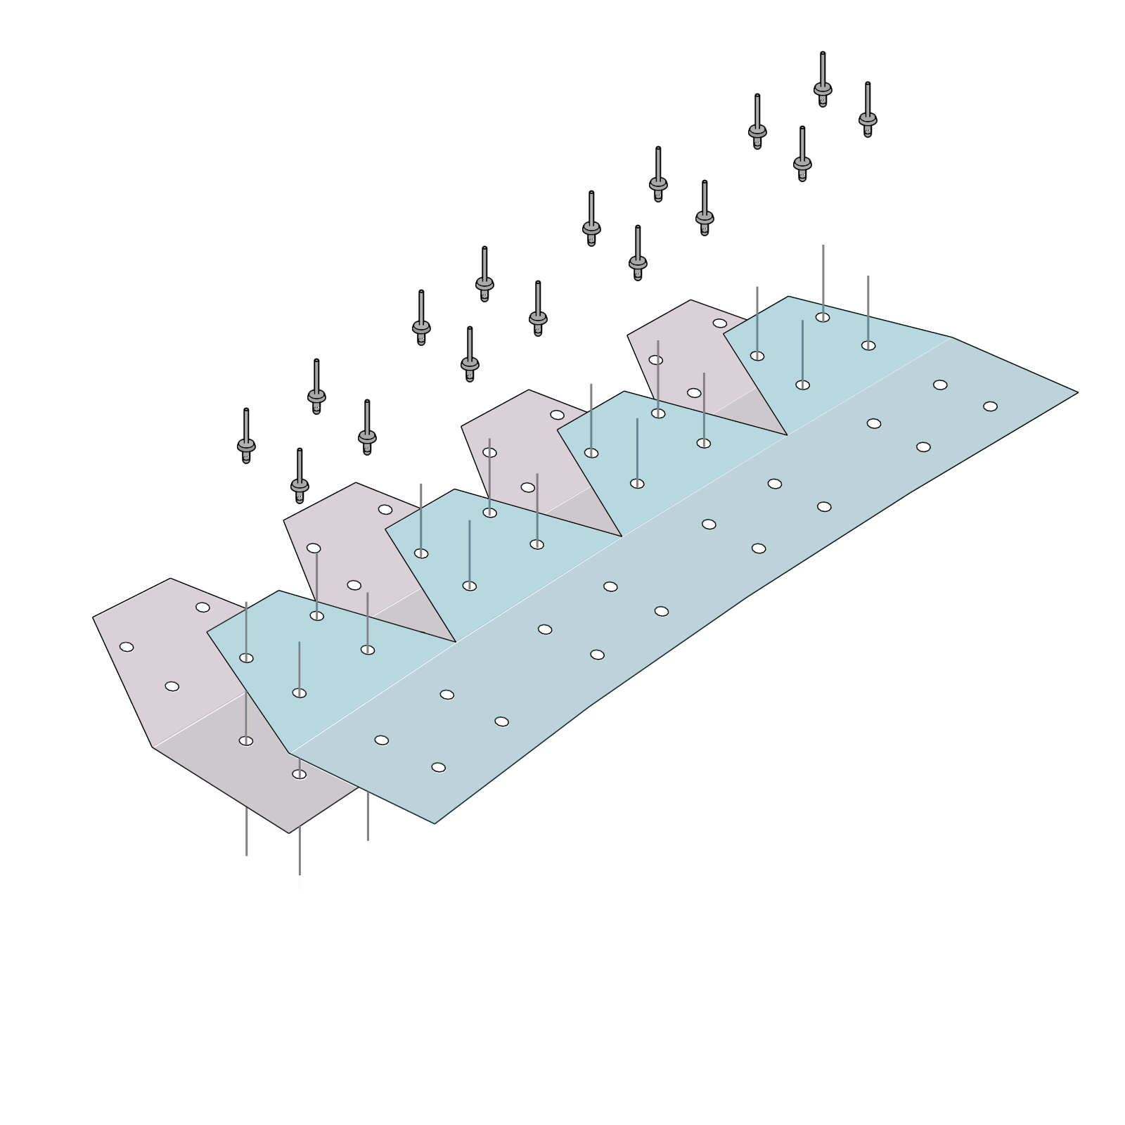
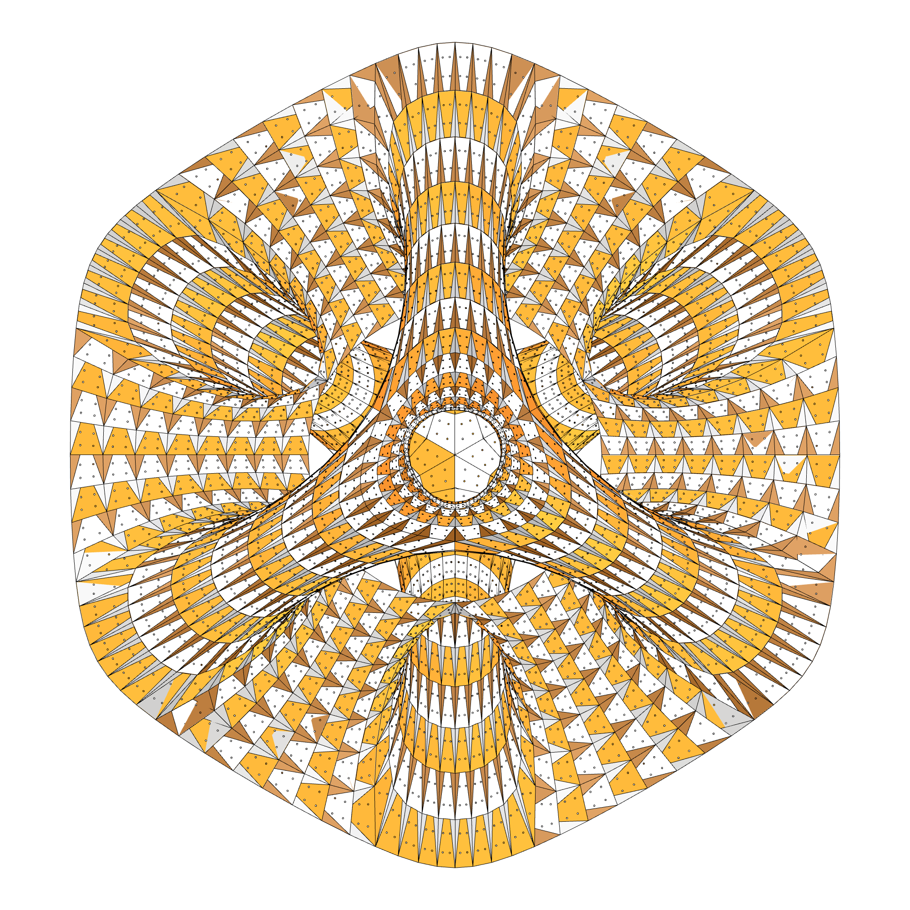
DRAGON_SKIN
FABRICATION DESIGN STRATEGY 2

Slide 27
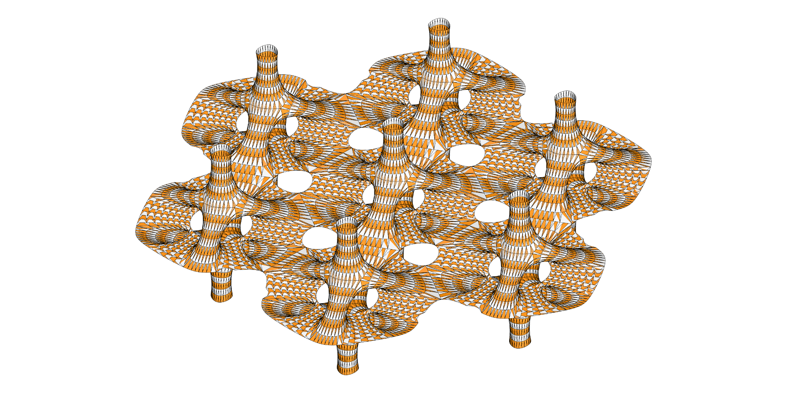
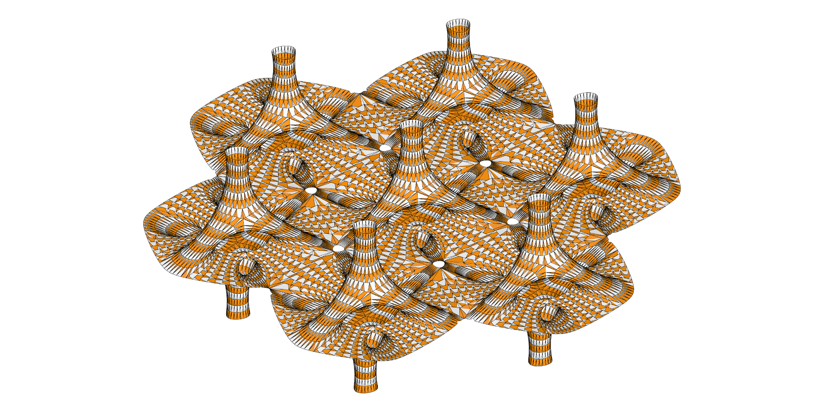
DRAGON SKIN

Slide 28
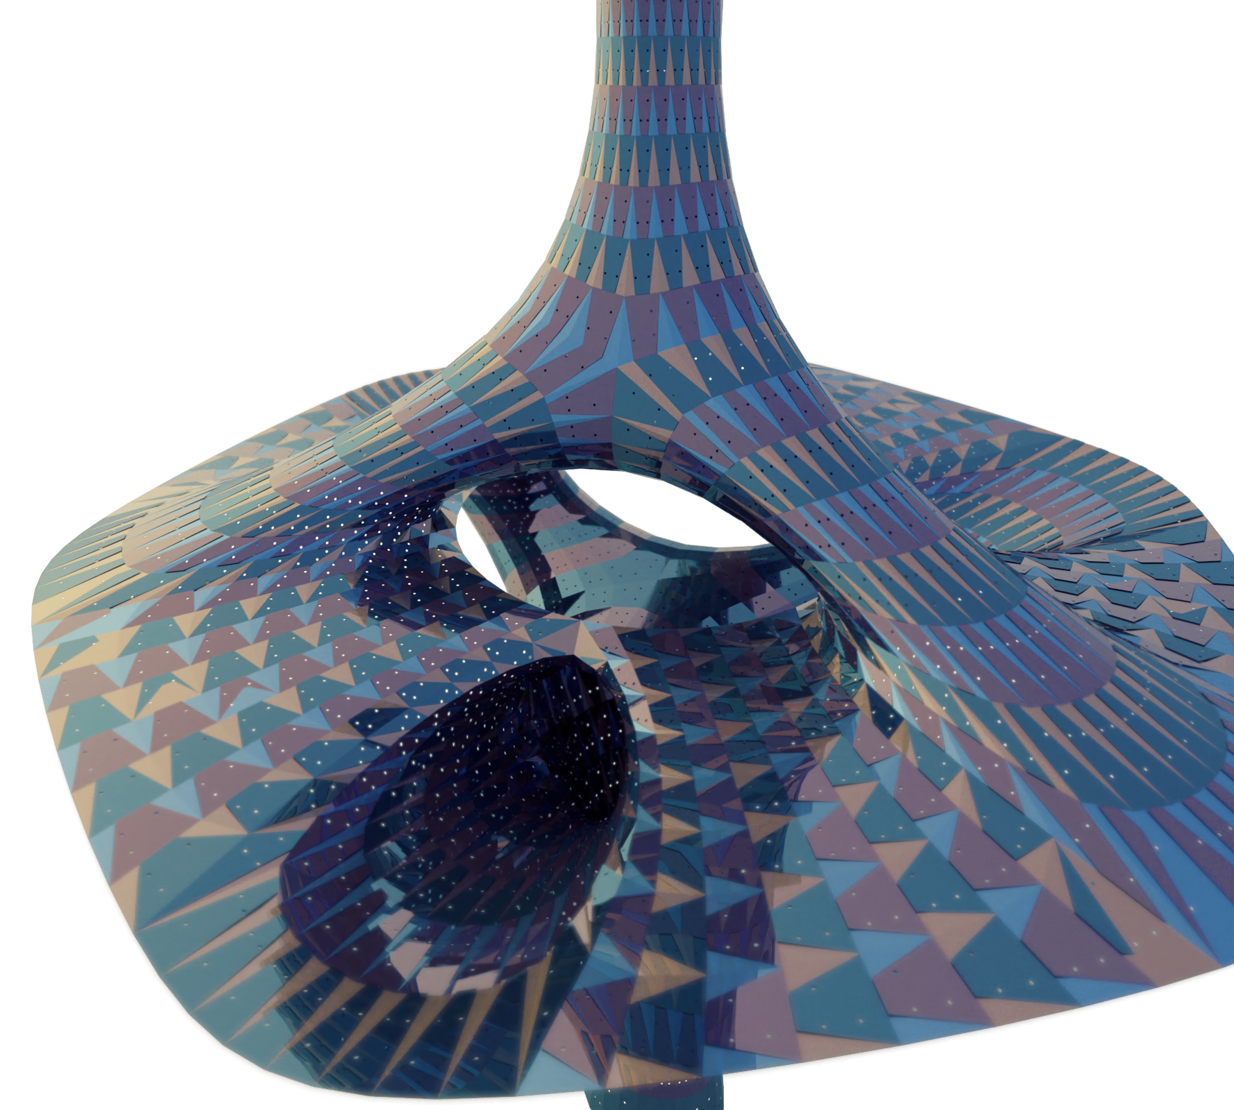
RENDERS

Slide 29
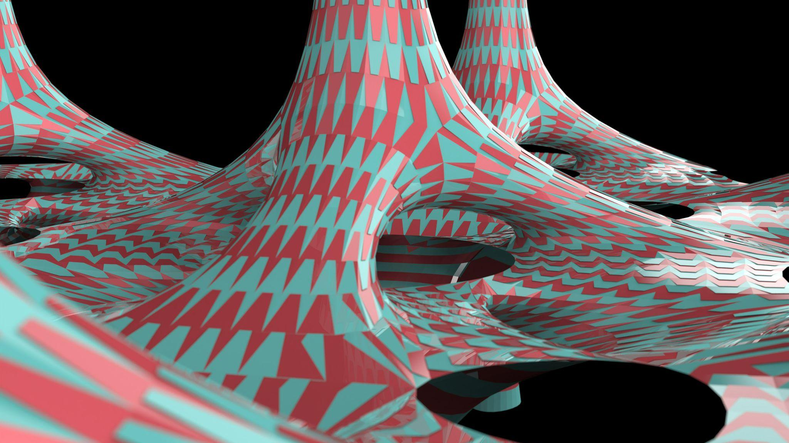
DRAGON CANDY
MeX_PRIMER
MeX_PRIMER

Slide 30

THANK YOU

